Slide 1
Episcopal Origins
April 29, 2025
Notes:
This presentation addresses:
the foundation of the episcopacy from scripture and the history of the early church,
terms used for a bishop,
the history of the establishment of the Anglican episcopacy in Canada, and
that the episcopacy is an essential part of the Anglican Church.

Slide 2
Campaign Goal
To bring the Anne Germond Legacy Fund to about $4,000,000, so that it generates an interest income to support the office of the Bishop of Algoma.
At 5%, $200,000 interest income would be generated annually.
Notes:
As mentioned in the first presentation

Slide 3
Office of the Bishop
The Bishop’s stipend, housing, travel & benefits;
administrative and/or executive support; and
office space, telephone, internet, computer.
Notes:
To encourage people to contribute to the Anne Germond Legacy Fund, we need to consider what the Bishop does, and what the role of the bishop is. This presentation reflects at the origins of the bishop in the early church and in the Church of England in Canada.

Slide 4
Early Church

Slide 5
Early Church
Deacon preaches the word and does outreach
Bishop or overseer, successor to the apostles
Elder (presbyter); as the church in a city grew, it formed new congregations overseen by the bishop but each lead by a presbyter. Later a presbyter was called a priest
A diocese became a geographical area overseen by a bishop, and
a province or archdiocese by an archbishop
Notes:
Stephen was among the first deacons appointed, Acts of the Apostles 6:1-7
The orders of deacon, priest, and bishop evolved over a period, and was affected by geography i.e. initially things were done differently in different places. The presbytery appeared to be a council of presbyters in the church.

Slide 6
Episcopas
Greek New Testament word for overseer, from which we derive episcopal and bishop.
In the NRSV version of the Bible, it is translated as overseer, bishop, guardian.
Notes:
In reference to Jesus being guardian of your souls. 1 Peter 2:25

Slide 7
Acts 1:20
In reference to Matthias being chosen to replace Judas,
“Let another take his position of overseer”.
Psalm 109:8 is quoted (remember NT quotes from Septuagint).
Notes:
Bishops are thought to be successors to the apostles.
For instance, Peter is named as the 1st Bishop of Rome, with Clement being the 2nd.

Slide 8
Philippians 1:1
Paul and Timothy, servants of Christ Jesus.
To all the saints in Christ Jesus, who are in Philippi with the bishops and deacons
Notes:
An early reference to the office of the bishop

Slide 9
Titus 1:7-9
For a bishop, as God’s steward, must be blameless; he must not be arrogant or quick-tempered or addicted to wine or violent or greedy for gain; but he must be hospitable, a lover of goodness, prudent, upright, devout, and self-controlled. He must have a firm grasp of the word that is trustworthy in accordance with the teaching, so that he may be able both to preach with sound doctrine and to refute those who contradict it.
Notes:
Demonstrates that the role is present, probable date of the Letter to Titus is 100 – 125 CE
Evidence of a role as teacher and defender of the faith
1 Timothy 3: 1-7 is a similar text to Titus
From the Consecration of a Bishop (BAS) to be in all things a faithful pastor and wholesome example for the entire flock of Christ

Slide 10
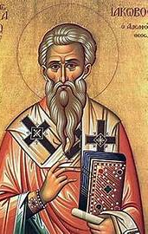
St. Ignatius
2nd bishop of Antioch in Syria
Wrote 7 letters on his journey to Rome
Martyred c. 115 CE
Notes:
Reference: For All the Saints: Prayers and Readings for Saints Days p. 308
Antioch was a major Christian centre. Paul and Barnabas were commissioned there for their missionary work to the Gentiles (Acts 13:1-3). The Gospel of Matthew is thought to be written at Antioch.

Slide 11
Letters of Ignatius: Smyrnaeans
Flee from schism as the source of mischief. You should all follow the bishop as Jesus Christ did the Father. Follow, too, the presbytery as you would the apostles; and respect the deacons as you would God’s law. Nobody must do anything that has to do with the Church without the bishop’s approval. You should regard that Eucharist as valid which is celebrated either by the bishop or by someone he authorizes. Where the bishop is present, there let the congregation gather, just as where Jesus Christ is, there is the Catholic Church. Without the bishop’s supervision, no baptisms or love feasts are permitted.
Notes:
Dealing with schism and the Judaizers are themes in St. Ignatius’ writings. Docetism was a heresy in his time.
Following the bishop is a strategy to maintain the unity of the church.
Note that the celebration of the Eucharist is done by the bishop or someone he authorises.
The three-fold order of ministry is present in the letters if Ignatius, however, it would be the 4th century before the three-fold order of ministry was used across the church.

Slide 12
Key Definitions & Terms

Slide 13
Terms for a Bishop
A bishop is someone who has been consecrated as a bishop.
The Bishop or Diocesan Bishop is the head of a diocese
A Coadjutor Bishop is elected to succeed as the Diocesan Bishop
A Suffragan Bishop is an assistant bishop
Notes:
The Diocese of Toronto has 2 suffragan bishops
A bishop may be appointed an Incumbent of a parish or be retired.

Slide 14
Province
A province consists of a minimum of 4 dioceses
3 bishops are required to consecrate a bishop
A Metropolitan Bishop is:
an Archbishop
Chair of Provincial Synod and Provincial Council
also a Diocesan Bishop
Notes:
For the dates of the founding of Canadian dioceses and provinces www.anglican.ca/ask/faq/

Slide 15
The Jurisdiction of the Provincial Synod of Ontario
The confirmation of the election, consecration and resignation of bishops within the Province
Provision for the ecclesiastical discipline and trial of bishops in the Province
Notes:
The Constitution and Canons of the Provincial Synod of the Ecclesiastical Province of Ontario Canon III - The Election and Resignation of Bishops
Diocese of Algoma Canon A-1 The Election of a Bishop sets out the procedures for the election of a bishop under the direction of the Metropolitan.

Slide 16
The Jurisdiction of the Provincial Synod of Ontario
With the consent of General Synod, and the dioceses affected, the division of the Province into dioceses, the establishment of missionary dioceses within the Province, the division of existing dioceses and the adjustment or re-arrangement of diocesan boundaries

Slide 17
The Anglican Church of Canada

Slide 18
Missionary Societies
Those societies founded for international outreach of the Church of England:
Society for the Propagation of the Gospel (SPG)
Church Missionary Society (CMS)
These societies started congregations of the Church of England in Canada
Initially Canadian Dioceses were overseas dioceses of the See of Canterbury
Notes:
This slide does not speak to episcopal origins, but it provides context for the growth of the church

Slide 19
The Church of England in Canada
A bishop is required to confirm people, consecrate deacons and ordain priests
Bishop Charles Inglis made Bishop of Nova Scotia in 1787, the first Bishop in Canada
necessitated by the American Revolutionary War 1776 – 1783 and the settlement of loyalists and refugees
Diocese of Quebec established 1793

Slide 20
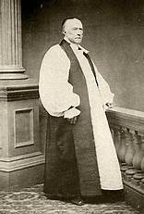
The Church of England in Canada
Bishop John Strachan
Diocese of Toronto established 1839
1st Bishop of Toronto, 1839-1867
demonstrated leadership required of a Bishop to address problems in the church and in his diocese
established Indian missions on Manitoulin Island and Sault Ste. Marie
Notes:
The territory of the Diocese of Algoma was part of the Diocese of Toronto in 1839

Slide 21
Establishing Diocesan Synod
The church needed lay representation in order to raise funds by collecting an offering during a worship service.
Informal meetings of clergy and lay people were held, at least as early 1851
Notes:
The Church of England was losing its revenue from the government, and it needed to raise funds from parishioners. the church needed lay representation in order to raise funds by collecting an offering during a worship service.
The following is background
The Mackenzie Rebellion happened in 1837.
In response to the Durham Report on the Affairs of British North America (1839), the British parliament passed the Act of Union, uniting the colonies of Upper and Lower Canada into the Province of Canada, and it was proclaimed in 1841. Upper Canada was renamed Canada West and Lower Canada was renamed Canada East.
1/7 of the public lands in Upper and Lower Canada had been reserved as a clergy reserve for the maintenance of a “Protestant clergy” in the 1791 Constitutional Act, which in practise supported the Church of England (C of E). In 1840, it was changed to support the Church of Scotland clergy as well as the C of E. In 1854, the Province of Canada passed a bill transferring the reserve-sale proceeds to the Municipalities Funds of Upper Canada and Lower Canada. In effect, this disestablished the Church of England and removed a significant source of its income.
In the 1840’s, the British government reduced grants to missionary societies, which meant Canadian churches had to become self-funding.
The Episcopal Church was the first Anglican Church to establish synods.

Slide 22
Establishing Diocesan Synod
Through the leadership of Bishop Strachan, the legislature of the Province of Canada in 1857 passed legislation to enable the Church of England to meet in Synod and make decisions, instituting the first of such synods in the British colonies
A synod is the legislature of a diocese, province or national church
It is comprised of bishop(s), clergy and laity
Notes:
Until 1857, the church in the British empire had to wait for the British parliament to enact the legislation to establish a synod. Canada set a precedent that allowed for the civil government to set up a church corporation to govern itself. This soon spread throughout the British Empire. Ref. Seeds Scattered and Sown: Studies in the History of Canadian Anglicanism edited by Norman Knowles.
Creating a synod meant the Bishop shared power with clergy and laity.

Slide 23
Establishing New Dioceses
The problems for a growing church in the colonies
The growing number of parishes was more than one Bishop could manage
New dioceses were needed in order to have a bishop to raise up and ordain deacons and priests, and supervise new parishes
The Parliament of Great Britian could only create a diocese in a colony in the British Empire
Notes:
Between 1815 and 1850 nearly a million people emigrated from Great Britian to British North America p. 107 CHC

Slide 24
Establishing New Dioceses
Through the leadership of Bishop Strachan, the legislature of the Province of Canada in 1857 passed legislation to create the Diocese of Huron
Notes:
The Province of Canada passing legislation to create was a work around the Parliament of Great Britian. It set a precedent in British colonies.

Slide 25
Establishing Ecclesiastical Provinces and General Synod
Province of Canada 1861
Province of Ontario 1862
Province of Rupert’s Land 1875
General Synod 1893
Province of British Columbia and Yukon 1914
The Church of England in Canada renamed as the Anglican Church of Canada 1955
Notes:
Creating the Province of Canada meant that the Canadian Church could now pass its own church law and could consecrate its own bishops.
As the number of dioceses increased, a province was able to subdivide to form a new province.

Slide 26
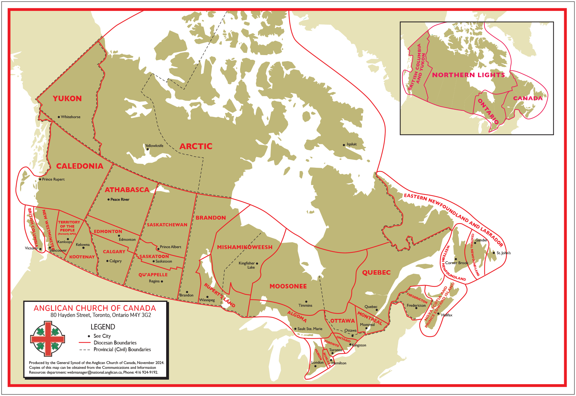

Slide 27
Anglicanism

Slide 28
Lambeth Quadrilateral
The Holy Scriptures of the Old and New Testaments, as ‘containing all things necessary to salvation’, and as being the rule and ultimate standard of faith.
The Apostles’ Creed, as the baptismal symbol; and the Nicene Creed, as the sufficient statement of the Christian Faith.
Notes:
First adopted by the Episcopal Church as the Chicago Quadrilateral in 1886. It was adopted at a Lambeth Conference in 1888 as a basis on which approach may be by God’s blessing made towards home reunion.
The Lambeth Conference is an international meeting of Anglican bishops. The idea for the Lambeth Conference was first suggested by Bishop Strachan.

Slide 29
Lambeth Quadrilateral
The two sacraments ordained by Christ himself – Baptism and the Supper of the Lord – ministered with unfailing use of Christ’s words of institution, and of the elements ordained by him.
The historic episcopate, locally adapted in methods of its administration to the varying needs of the nations and peoples called of God into the unity of God’s Church
Notes:
The point of sharing the Lambeth Quadrilateral is to underscore how important the historic episcopate to the Anglican concept of the church.

Slide 30
Questions, Comments?
Next presentation, The Office of the Bishop of Algoma

