Slide 1
The Office of the Bishop of Algoma
April 29, 2025
Notes:
The previous presentation addressed the origins of the office of the Bishop in the Early Church and the development of the episcopacy in the Anglican Church of Canada. This presentation will build on that presentation.
This presentation will look at the office of the Bishop from the point of view of how the Bishop uses her time, and from the Ordinal.
If you wish to know what Anglicans believe and think, one goes back to our liturgy.

Slide 2
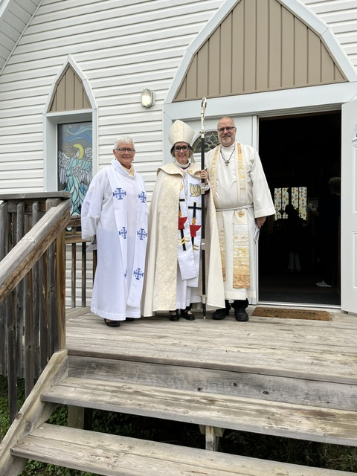
What are the Roles of the Bishop?
What does the Bishop do?
Notes:
Ask, what does the Bishop do?

Slide 3
How People Experience the Bishop?
when the Bishop visits their parish, about every 2 years
when they are confirmed
when they attend an ordination
when they attend the funeral of a priest or deacon that the Bishop conducts

Slide 4
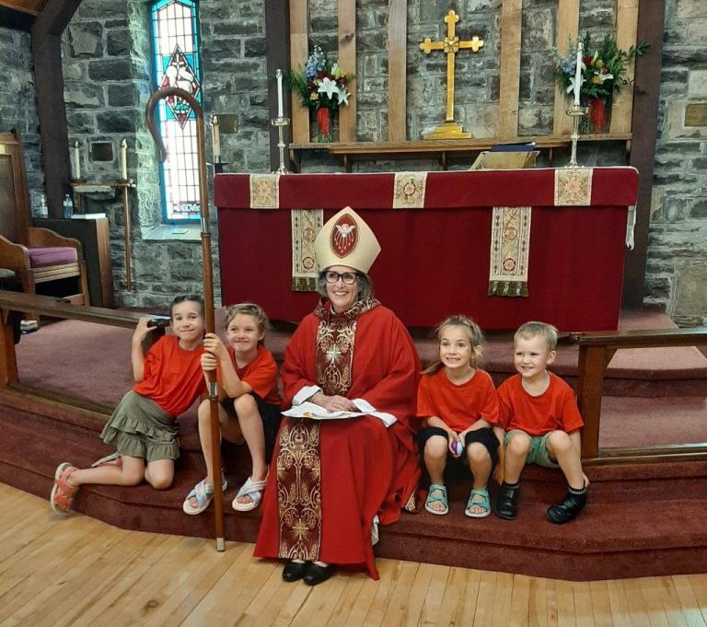

Slide 5
How People Experience the Bishop?
when they participate in a Deanery teaching day in which the Bishop gives a talk
through the written word communicated in:
Diocese of Algoma – Latest News sent by email and posted on www.dioceseofalgoma.com
posts on Facebook,
pastoral letters to the diocese, and
Ad Clerum to clergy

Slide 6
How People Experience the Bishop?
as a member of Diocesan Synod
as a member of Diocesan Executive Committee
when they attend a Diocesan clergy retreat
when they attend a Diocesan Lay Reader conference

Slide 7
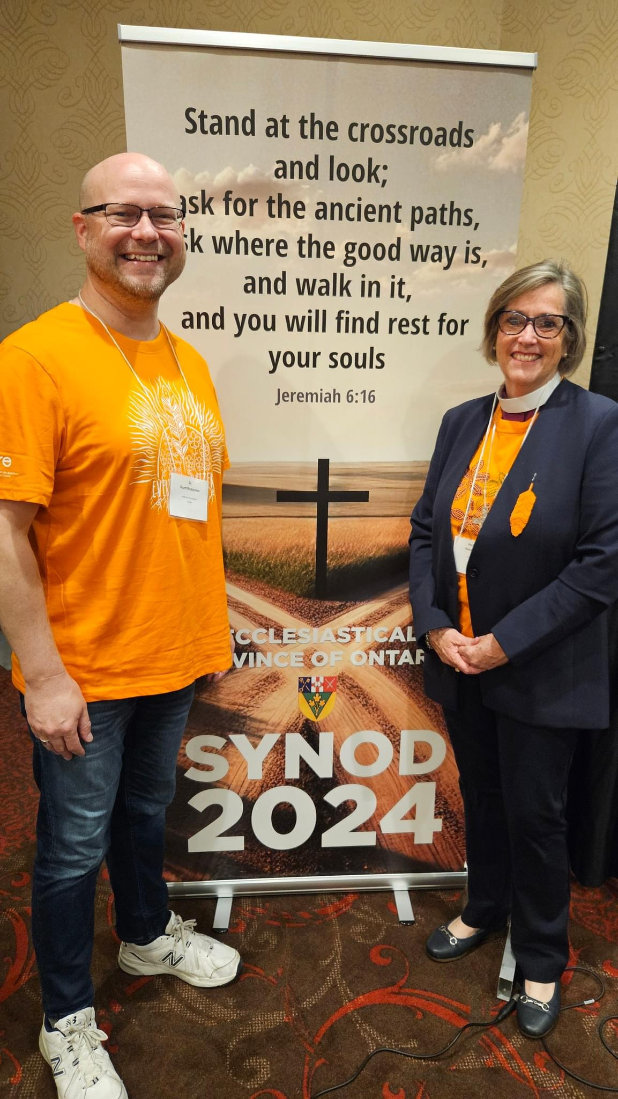

Slide 8
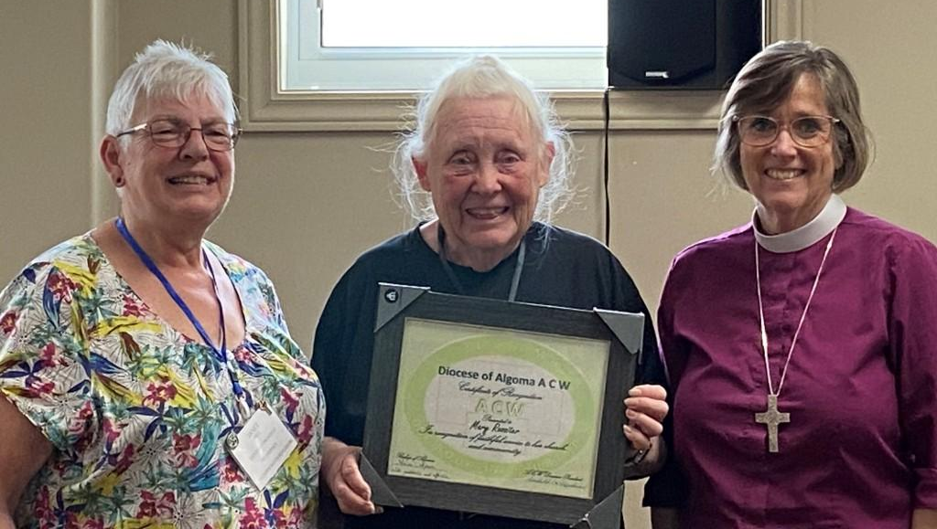
How People Experience the Bishop?
through ecumenical events that the Bishop participates in, such as the Week of Prayer for Christian Unity and the World Day of Prayer
whey they attend a Diocesan ACW Annual meeting

Slide 9
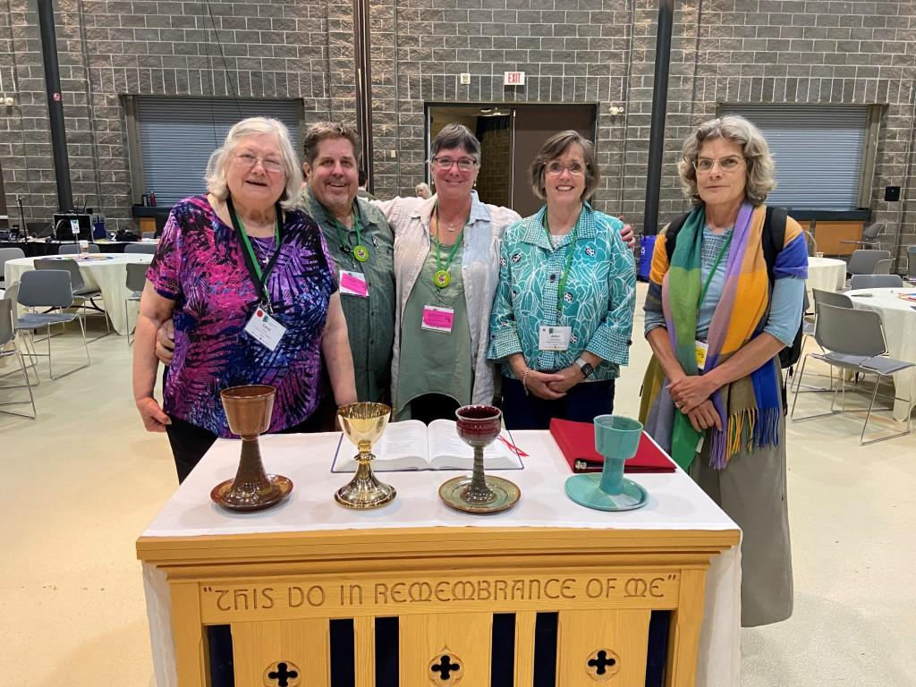

Slide 10
How People Experience the Bishop?
when their parish is filling the vacancy of the Incumbent
through ministry reviews with church wardens and the incumbent
when their parish has a conflict with the Synod Office, or when their parish has an internal conflict, and the Bishop intervenes
Notes:
Archdeacon and Deanery Officials initial recourse for a conflict, then the Bishop

Slide 11
Roles understood from People’s Experience
leadership and management of the Diocese – oversight - care for parishes
teaching - missional leadership
raising up vocations to the diaconate and priesthood (ordination)
provision of sacraments: confirmation

Slide 12
Prayer and Study
A bishop maintains a practise of prayer and study
If a bishop is to be a good teacher/preacher, time for lifelong learning and retreat is essential to every bishop’s life and ministry

Slide 13
Work in the Province
attends Provincial House of Bishops
attends Provincial Synod, held once every 3 years
attends Provincial Council, meets in the spring and in the fall
may serve on a Provincial committee(s)
participates in consecrations of bishops within the Province

Slide 14
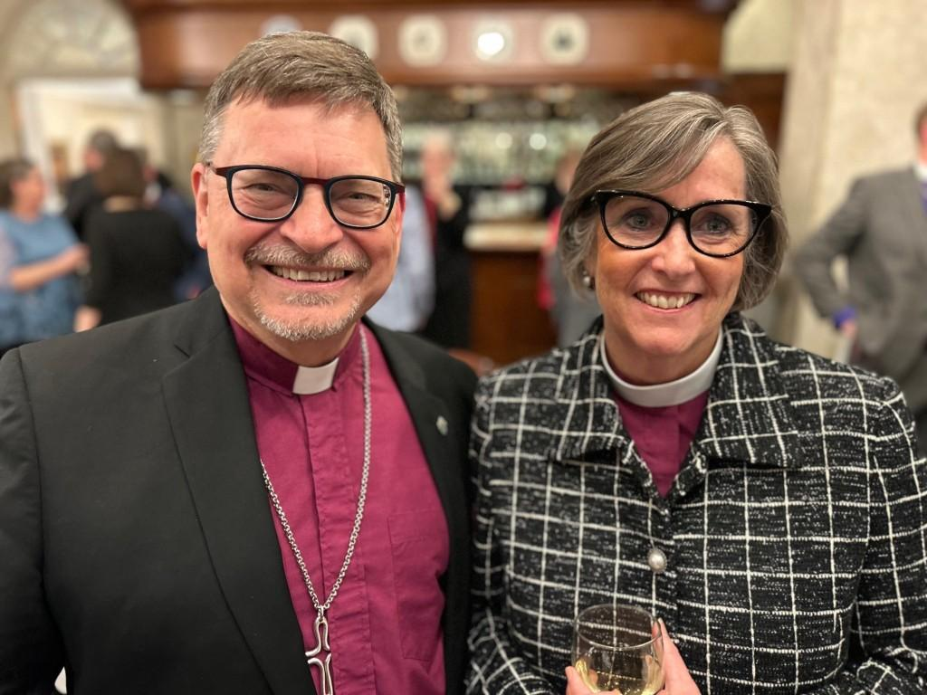

Slide 15
Work in the National Church and Anglican Communion
attends National House of Bishops, meets in the spring and fall - one week each
attends General Synod, held once every 3 years
may serve on General Synod Council or committee(s)

Slide 16
Work in the National Church and Anglican Communion
every bishop is asked to participate in a ministry of the Anglican Church of Canada or the Communion
attends the Bishops of the Communion Conference (Lambeth Conference), held once every 10 years at Lambeth Palace
Notes:
+Linda was a member of ARCIC; +Andrew is in England attending Compass Rose. For six years +Anne was on the board of the Anglican Foundation of Canada. All these ministries provide a vital link between the bishop and other organizations as the bishop offers their gifts of ministry.
The Archbishop of Canterbury first convened the Lambeth Conference in 1865 at the request of the Canadian House of Bishops. Bishop Strachan conceived of the idea.
Connects our Diocese with the wider church and the wider church with our Diocese. In doing so, the Bishop is an instrument of unity.

Slide 17
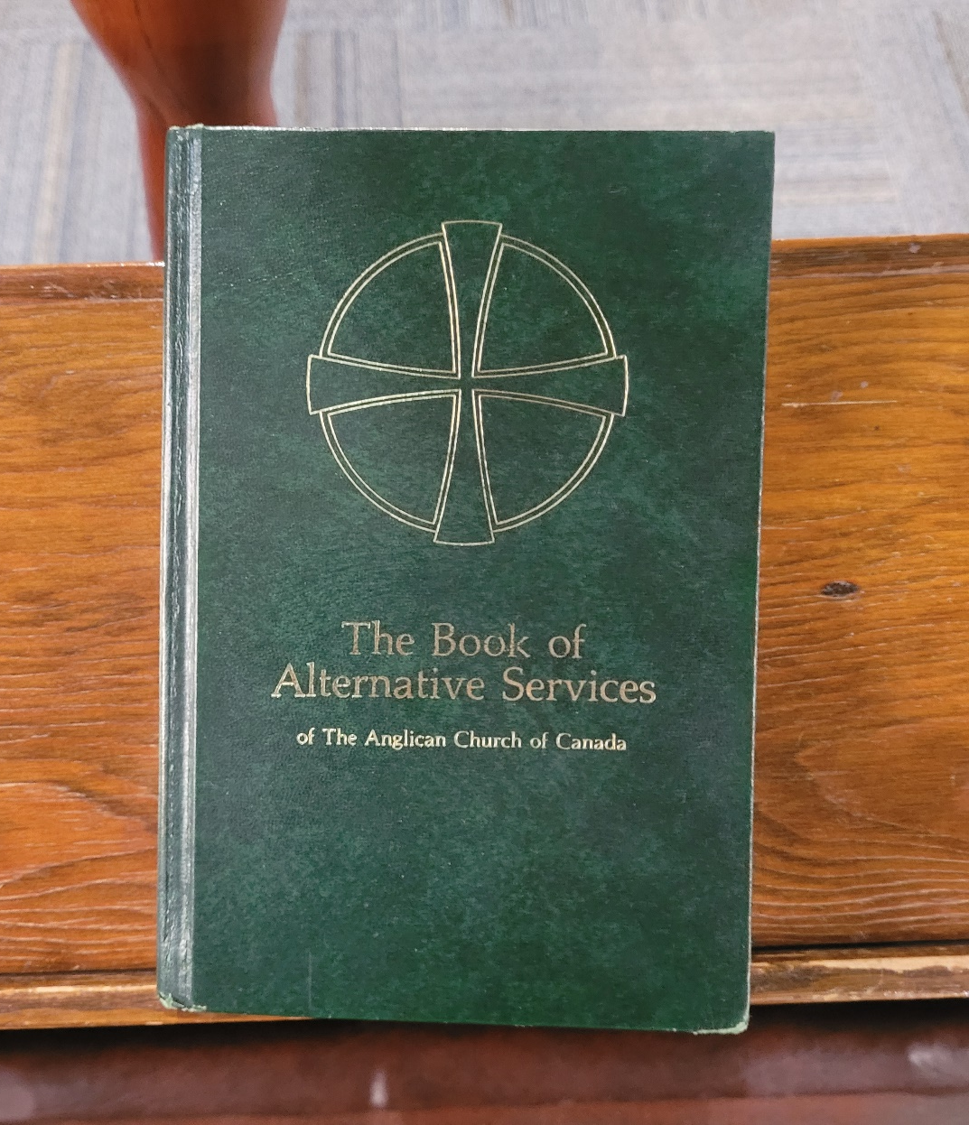
What are the Roles of the Bishop?
From the Ordinal

Slide 18
The Ordination of a Bishop, the Examination
Anne, the people have chosen you and have affirmed their trust in you by acclaiming your election. A bishop in God’s holy Church is called to be one with the apostles in proclaiming Christ’s resurrection and interpreting the Gospel, and to testify to Christ’s sovereignty as Lord of lords and King of kings.

Slide 19
The Ordination of a Bishop, the Examination
You are called to guard the faith, unity, and discipline of the Church; to celebrate and to provide for the administration of the sacraments of the new covenant; to ordain priests and deacons, and to join in ordaining bishops; and to be in all things a faithful pastor and wholesome example for the entire flock of Christ.

Slide 20
The Ordination of a Bishop, the Examination
With your fellow bishops you will share in the leadership of the Church throughout the world. Your heritage is the faith of patriarchs, prophets, apostles, and martyrs, and those of every generation who have looked to God in hope. Your joy will be to follow him who came not to be served but to serve, and to give his life a ransom for many.
BAS p. 636

Slide 21
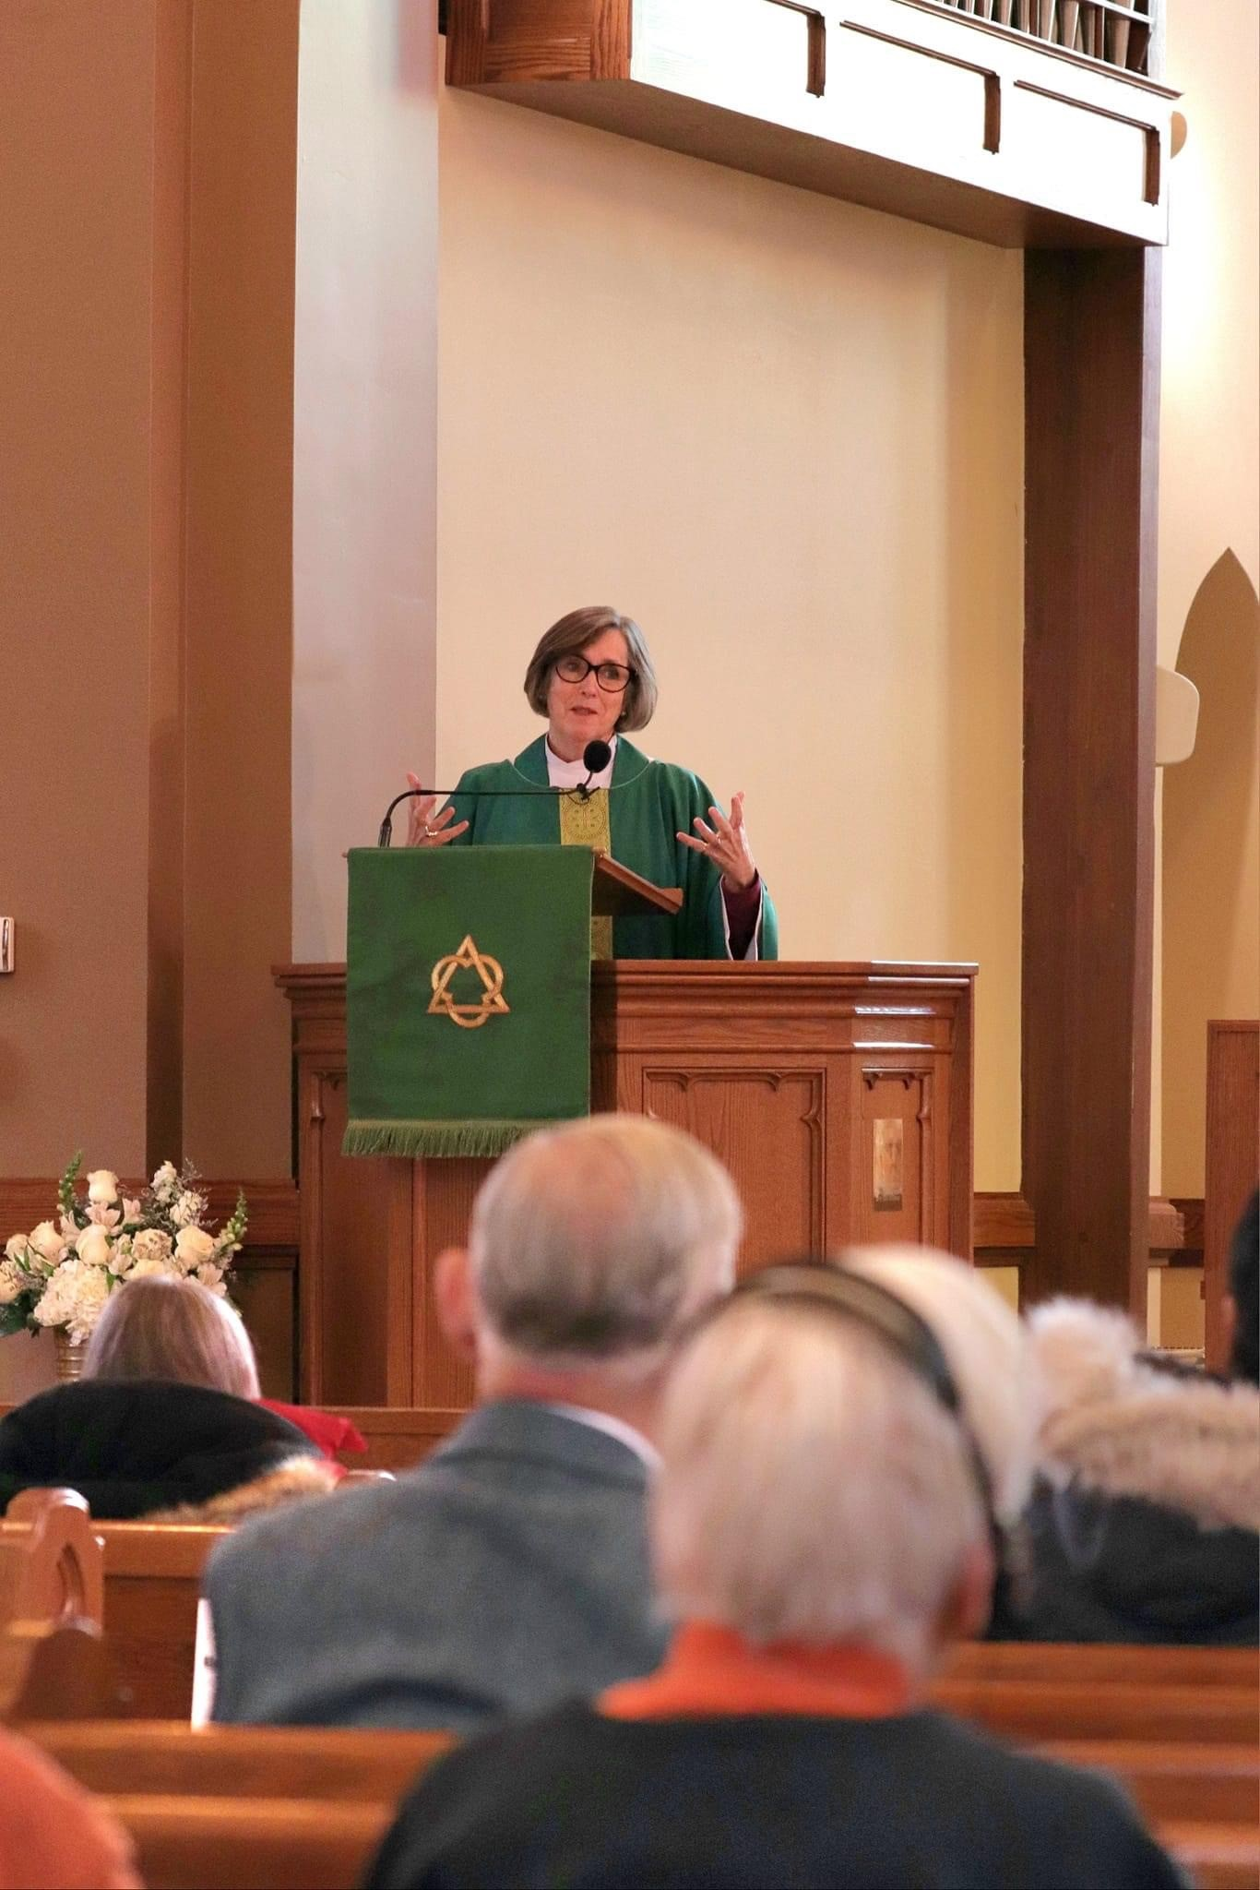
Guard the faith, unity, and discipline of the Church

Slide 22
Continuity - Successor of the Apostles
Bishops continue the work of the apostles in three ways:
upholding, expounding and promoting the apostolic faith;
leading the faithful in the apostolic mission of the gospel in the midst of the world; and
being a visible link through history, by continuous succession, with the Church of the apostles.
Becoming a Bishop p. 24

Slide 23
Teacher and Defender of the Faith
through their own teaching/preaching
raise up others to teach
ensure opportunities for teaching to occur, such as Diocesan Clergy Retreat and Diocesan Synod
missional aspect is when teaching becomes apologetic, i.e. explain Christianity to the wider society

Slide 24
Teacher and Defender of the Faith
monitor situation in the church and respond appropriately
correct inappropriate teaching, exercise discipline with clergy and lay people appointed to positions in the Diocese
Notes:
The General Synod Canon on Discipline lists heresy as an offense.
Echo of St. Ignatius.

Slide 25
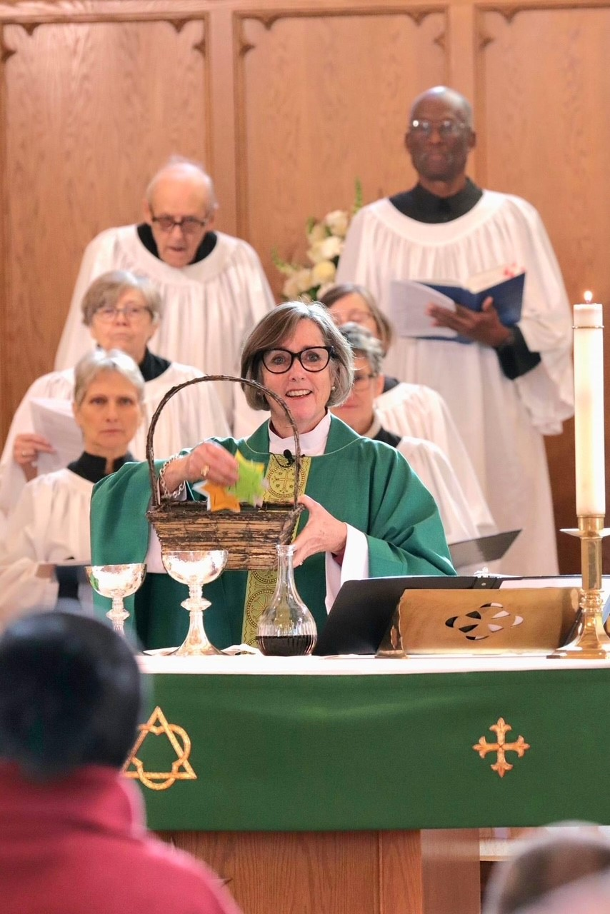
Provide for the Administration of the Sacraments of the New Covenant

Slide 26
Provide for the Administration of the Sacraments of the New Covenant
Incumbents, normally priests (presbyters), are licenced to spiritual and pastoral care for a parish.
When there is no Incumbent, the Bishop ensures that clergy or Diocesan Lay Readers provide spiritual and pastoral care and administer the sacraments.
The Bishop continues as a priest and may provide spiritual and pastoral care for a parish.

Slide 27
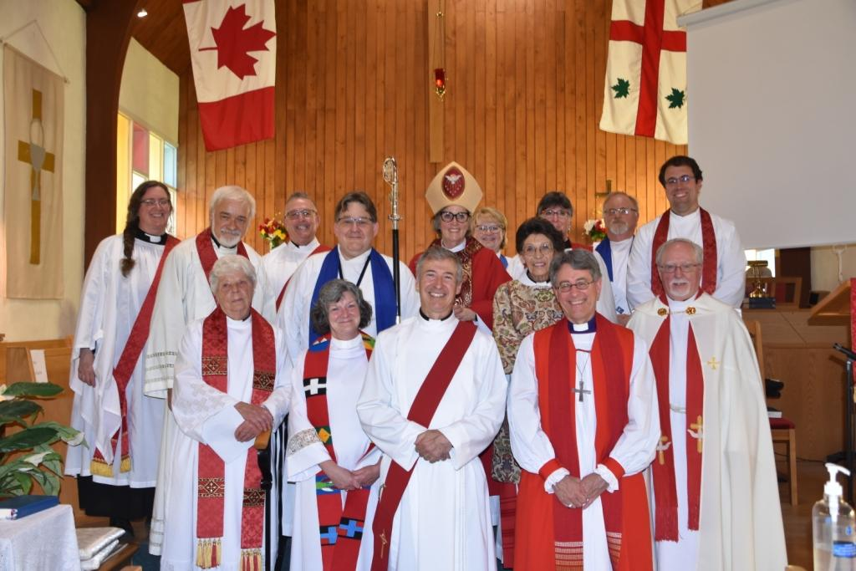
Ordain Priests and Deacons, and to Join in Ordaining Bishops

Slide 28
Raising Up Vocations
The Bishop will work with incumbents, archdeacons, pastoral chaplains, and theological colleges to mentor and select candidates for ordination (postulants).
A pastoral chaplain is a priest or bishop that the Bishop appoints for each deanery to assist in talking with those discerning a call to ministry.

Slide 29
Raising Up Vocations
The Bishop meets with the Diocesan Postulancy Commission to decide on whether to ordain people.

Slide 30
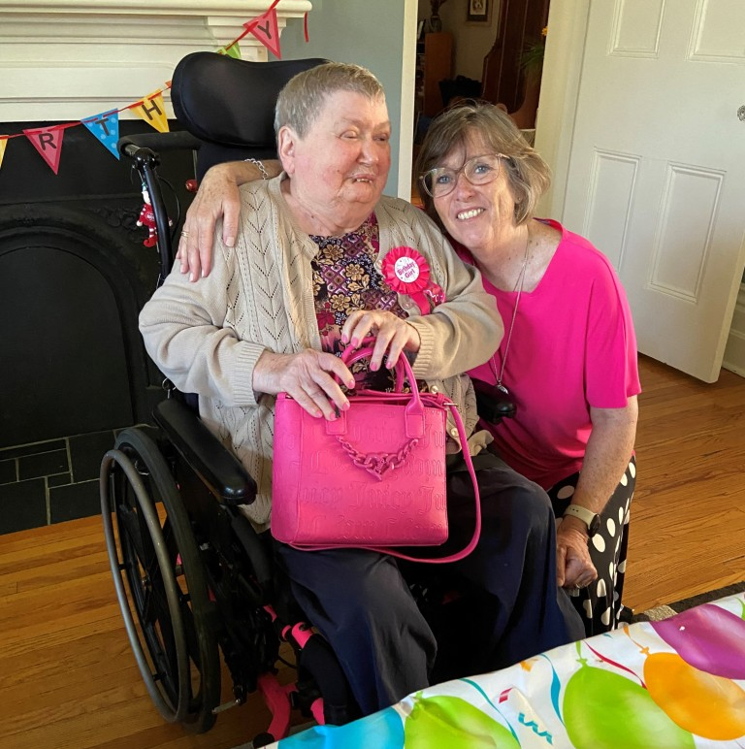
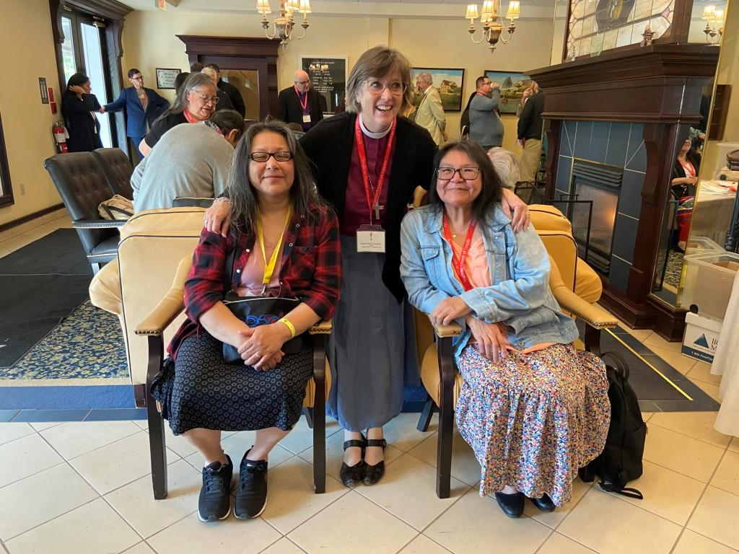
Be in all things a faithful pastor and wholesome example for the entire flock of Christ

Slide 31
Care for Congregations
The Bishop licences Incumbents, normally priests (presbyters), to provide spiritual and pastoral care for a parish.
Archdeacons are appointed to assist the Bishop in the oversight of parishes, and Territorial Archdeacons represent the Bishop in their deanery.

Slide 32
Care for Congregations
The Bishop is responsible for ensuring internal conflicts and issues between the Incumbent and parish are resolved, if they are not able to resolve it themselves.
The Bishop may exercise a discipline function with clergy and lay people appointed to positions in the Diocese.

Slide 33
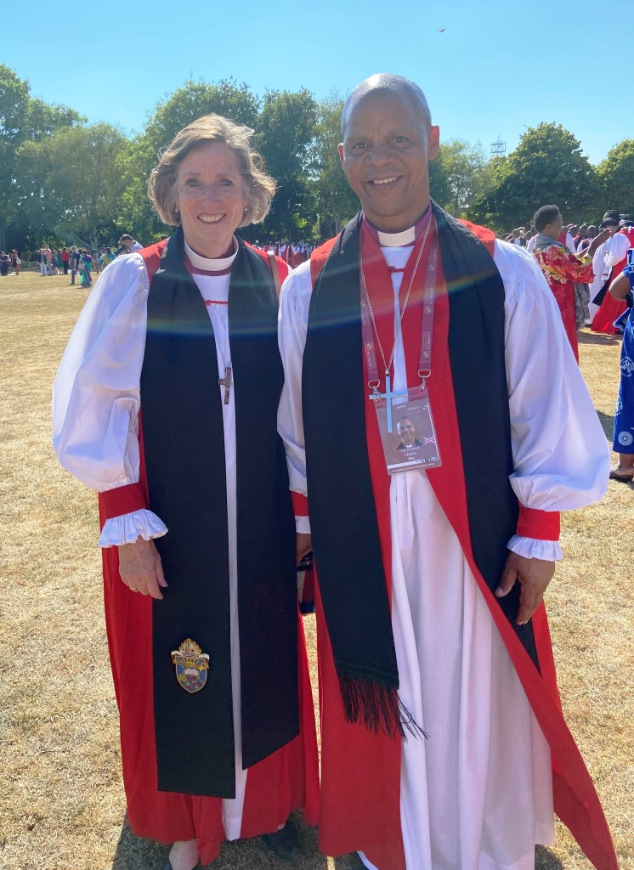
With your fellow bishops you will share in the leadership of the Church throughout the world

Slide 34
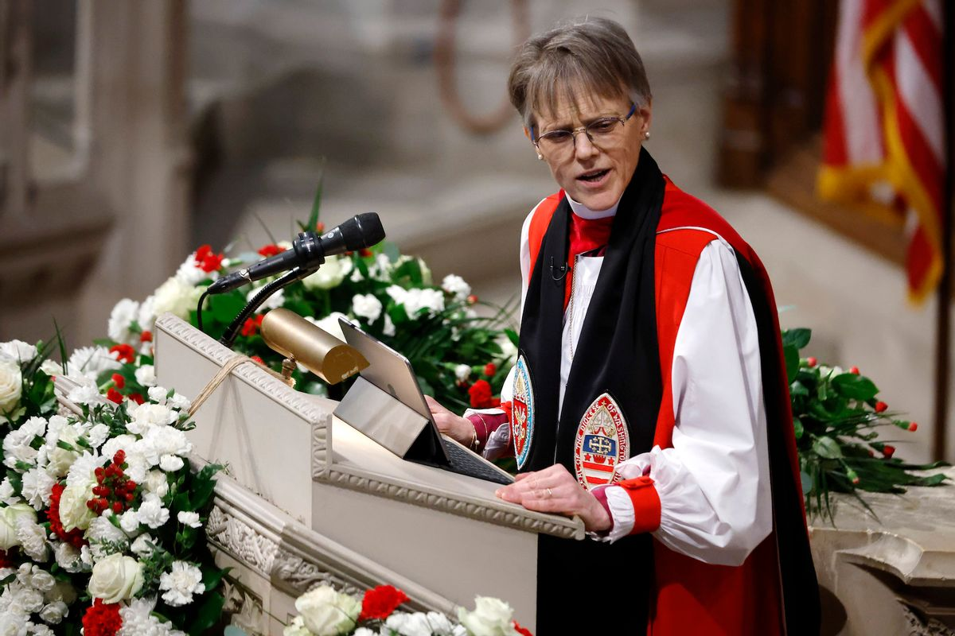
Continuity - Instrument of Unity
As chief pastor, the Bishop links one parish to another, representing the diocese to the wider church and the wider church to the diocese.
Bishops often are on the forefront of local, national, and global issues, speaking the word of faith to the needs of the world.
Notes:
Bishop Mariann Budde of the Diocese of Washington

Slide 35
Continuity - Instrument of Unity
Bishops are one vital and visible way of showing that the Anglican Church is a continuation of the original Apostolic church.
Bishops provide leadership for ecumenical dialogues.

Slide 36
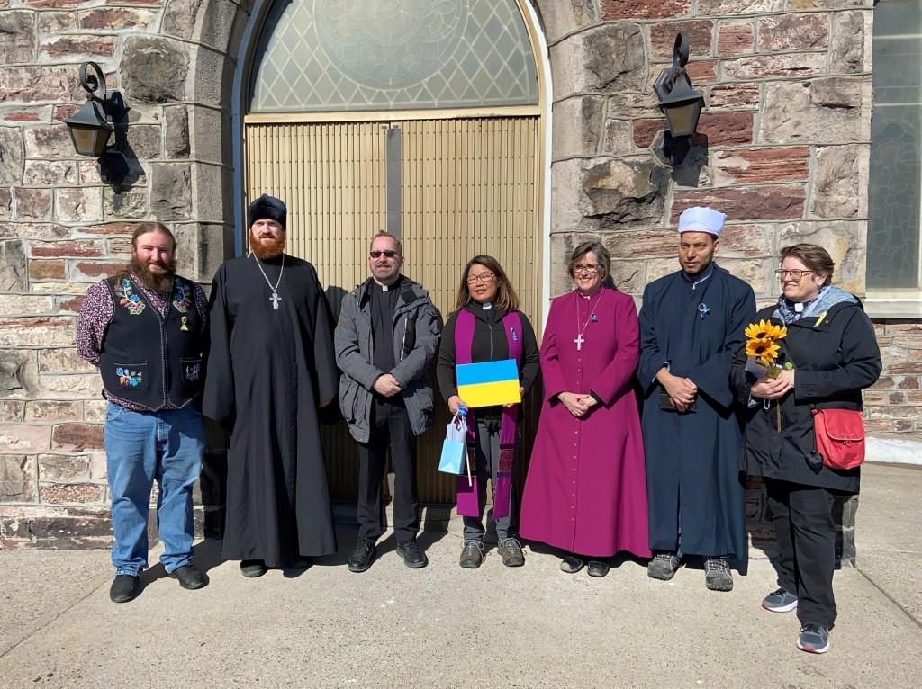

Slide 37
Episcopally-led
To oversee the Diocese, the Bishop listens to the clergy and people, develops courses of action with them, and with them, discerns Jesus’ and the Holy Spirit’s leading.
In the oversight of the Diocese, the Bishop is guided by scripture, the tradition of the church, and reason.

Slide 38
Synodically-governed
Synod is comprised of 3 houses, Bishop, clergy and people, and for decisions to pass each house must agree.
Synod is a legislature.
In Algoma, Diocesan Synod meets every 2 years.
In the clergy and people, there are tremendous gifts and resources, including financial resources.
Notes:
Discuss the 3 houses of Synod in Diocesan Synod. The House of Bishop has one member, and it operates when concurrence is given or withheld at the closing of Synod.
As a legislature, Synod passes canons (laws) and motions that become policy or direction for the Executive Committee, deaneries and parishes.

Slide 39
Why does Algoma need to be led by a local Bishop?

Slide 40
What are the Alternatives?
The people of Algoma will always have a bishop.
If Algoma cannot fund a bishop, other arrangements will be made, but the Bishop will not reside in Algoma:
as in the case of Moosonee, the Metropolitan may provide oversight temporarily; or
a permanent solution would be the realignment of the Diocese with other dioceses.

Slide 41
Benefits of a Local Bishop
One with the time and resources to walk alongside congregations, visit deaneries, and strengthen the ties that bind our faith community.
Understands better the particular context of northern Ontario and more able to speak for the people of this region.
More able to raise up vocations.
Better placed to guide parishes through change, foster innovation, and create new opportunities for collaboration.

Slide 42
The Office of the Bishop
The Bishop’s stipend, housing, travel & benefits;
administrative and/or executive support; and
office space, telephone, internet, computer.
Notes:
To accomplish these tasks, the Bishop relies on her Administrative Assistant, and when the position is filled, the Executive Officer of the Diocese.

Slide 43
Conclusion
The success of this campaign will ensure that:
the office of the Bishop is funded
our diocese will always be led by a local Bishop
the Bishop offers episcopal ministry, and
Anglican ministry is supported in our communities by a Bishop who understands the life of northern Ontario.

Slide 44
Questions? Comments?

