Slide 1
Diocesan Synod
Presentation
April 29, 2025
Notes:
This presentation addresses:
the foundation of the episcopacy from scripture and the history of the early church,
the history of the establishment of the Anglican episcopacy in Canada.
The role of the Bishop of Algoma

Slide 2
Attendance and Offerings Declining
Source: Synod Convening Circulars

Slide 3
Campaign Goal
To bring the Anne Germond Legacy Fund to $4,000,000, so that it generates sufficent interest income to support the office of the Bishop of Algoma.
At 5%, $200,000 interest income would be generated annually.

Slide 4
Office of the Bishop
The Bishop’s stipend, housing, travel & benefits;
administrative and/or executive support; and
office space, telephone, internet, computer.

Slide 5
Episcopal Origins
Early Church
Notes:
Best to educate people about what you are fund-raising for.
As Anglicans, we do theology using scripture, tradition, and reason.
Thank Archbishop Anne Germond for her assistance in preparing this presentation

Slide 6
Early Church
Deacon preaches the word and does outreach
Bishop or overseer, successor to the apostles
Elder (presbyter); as the church in a city grew, it formed new congregations overseen by the bishop but each lead by a presbyter. Later a presbyter was called a priest
A diocese became a geographical area overseen by a bishop, and
a province or archdiocese by an archbishop
Notes:
Stephen was among the first deacons appointed, Acts of the Apostles 6:1-7
The orders of deacon, priest, and bishop evolved over a period, and was affected by geography i.e. initially things were done differently in different places. The presbytery appeared to be a council of presbyters in the church.

Slide 7
Episcopas
Greek New Testament word for overseer,
from which we derive episcopal and bishop.
In the NRSV version of the Bible, it is translated as overseer, bishop, guardian.
Notes:
In reference to Jesus being guardian of your souls. 1 Peter 2:25

Slide 8
Acts 1:20
In reference to Matthias being chosen to replace Judas,
“Let another take his position of overseer”.
Psalm 109:8 is quoted (remember NT quotes from Septuagint).
Notes:
Bishops are thought to be successors to the apostles.
For instance, Peter is named as the 1st Bishop of Rome, with Clement being the 2nd.

Slide 9
Philippians 1:1
Paul and Timothy, servants of Christ Jesus.
To all the saints in Christ Jesus, who are in Philippi with the bishops and deacons
Notes:
An early reference to the office of the bishop

Slide 10
Titus 1:7-9
For a bishop, as God’s steward, must be blameless;
he must not be arrogant or quick-tempered or addicted to wine or violent or greedy for gain; but he must be hospitable, a lover of goodness, prudent, upright, devout, and self-controlled. He must have a firm grasp of the word that is trustworthy in accordance with the teaching,
so that he may be able both to preach with sound doctrine and to refute those who contradict it.
Notes:
Demonstrates that the role is present, probable date of the Letter to Titus is 100 – 125 CE
Evidence of a role as teacher and defender of the faith
1 Timothy 3: 1-7 is a similar text
From the Consecration of a Bishop (BAS) to be in all things a faithful pastor and wholesome example for the entire flock of Christ

Slide 11

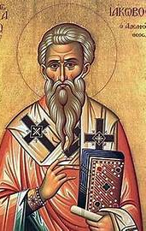
St. Ignatius
2nd bishop of Antioch in Syria
Wrote 7 letters on his journey to Rome
Martyred c. 115 CE
Notes:
Reference: For All the Saints: Prayers and Readings for Saints Days p. 308
Antioch was a major Christian centre. Paul and Barnabas were commissioned there for their missionary work to the Gentiles (Acts 13:1-3). The Gospel of Matthew is thought to be written at Antioch.

Slide 12
Letters of Ignatius: Smyrnaeans
Flee from schism as the source of mischief. You should all follow the bishop as Jesus Christ did the Father. Follow, too, the presbytery as you would the apostles; and respect the deacons as you would God’s law. Nobody must do anything that has to do with the Church without the bishop’s approval. You should regard that Eucharist as valid which is celebrated either by the bishop or by someone he authorizes. Where the bishop is present, there let the congregation gather, just as where Jesus Christ is, there is the Catholic Church. Without the bishop’s supervision, no baptisms or love feasts are permitted.
Notes:
Dealing with schism and the Judaizers are themes in St. Ignatius’ writings. Docetism was a heresy in his time.
Following the bishop is a strategy to maintain the unity of the church.
Note that the celebration of the Eucharist is done by the bishop or someone he authorises.
The three-fold order of ministry is present in the letters if Ignatius, however, it would be the 4th century before the three-fold order of ministry was used across the church.

Slide 13
Key Definitions & Terms

Slide 14
Terms for a Bishop
A bishop is someone who has been consecrated as a bishop.
The Bishop or Diocesan Bishop is the head of a diocese
A Coadjutor Bishop is elected to succeed as the Diocesan Bishop
A Suffragan Bishop is an assistant bishop
Notes:
The Diocese of Toronto has 2 suffragan bishops.
A bishop may be appointed an Incumbent of a parish or be retired.

Slide 15
Province
A province consists of a minimum of 4 dioceses
  3 bishops are required to consecrate a bishop
A Metropolitan Bishop is:
  an Archbishop
  Chair of Provincial Synod and Provincial Council
  also a Diocesan Bishop
Notes:
For the dates of the founding of Canadian dioceses and provinces www.anglican.ca/ask/faq/

Slide 16
The Jurisdiction of the Provincial Synod of Ontario
The confirmation of the election, consecration and resignation of bishops within the Province
Provision for the ecclesiastical discipline and
trial of bishops in the Province
Notes:
The Constitution and Canons of the Provincial Synod of the Ecclesiastical Province of Ontario Canon III - The Election and Resignation of Bishops
Diocese of Algoma Canon A-1 The Election of a Bishop sets out the procedures for the election of a bishop under the direction of the Metropolitan.

Slide 17
The Jurisdiction of the Provincial Synod of Ontario
With the consent of General Synod, and the dioceses affected, the division of the Province into dioceses, the establishment of missionary dioceses within the Province, the division of existing dioceses and the adjustment or re-arrangement of diocesan boundaries

Slide 18

Episcopal Origins
The Anglican Church of Canada

Slide 19
Missionary Societies
Those societies founded for international outreach of the Church of England:
  Society for the Propagation of the Gospel (SPG)
  Church Missionary Society (CMS)
These societies started congregations of the
Church of England in Canada
Initially Canadian Dioceses were overseas dioceses of the See of Canterbury
Notes:
This slide does not speak to episcopal origins, but it provides context for the growth of the church

Slide 20
The Church of England in Canada
A bishop is required to confirm people, consecrate deacons and ordain priests
Bishop Charles Inglis made Bishop of Nova Scotia in 1787, the first Bishop in Canada
  necessitated by the American Revolutionary War
  1776 – 1783 and the settlement of loyalists and refugees
Diocese of Quebec established 1793

Slide 21
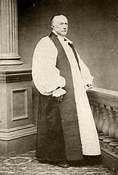
The Church of England in Canada
Bishop John Strachan
  Diocese of Toronto established 1839
  1st Bishop of Toronto, 1839-1867
  demonstrated leadership required
  of a Bishop to address problems
  in the church and in his diocese
  established Indian missions on
  Manitoulin Island and Sault Ste. Marie
Notes:
The territory of the Diocese of Algoma was part of the Diocese of Toronto in 1839

Slide 22
Establishing Diocesan Synod
The church needed lay representation in order to raise funds by collecting an offering during a worship service.
Informal meetings of clergy and lay people were held, at least as early 1851
Notes:
The Church of England was losing its revenue from the government, and it needed to raise funds from parishioners. the church needed lay representation in order to raise funds by collecting an offering during a worship service.
The following is background
The Mackenzie Rebellion happened in 1837.
In response to the Durham Report on the Affairs of British North America (1839), the British parliament passed the Act of Union, uniting the colonies of Upper and Lower Canada into the Province of Canada, and it was proclaimed in 1841. Upper Canada was renamed Canada West and Lower Canada was renamed Canada East.
1/7 of the public lands in Upper and Lower Canada had been reserved as a clergy reserve for the maintenance of a “Protestant clergy” in the 1791 Constitutional Act, which in practise supported the Church of England (C of E). In 1840, it was changed to support the Church of Scotland clergy as well as the C of E. In 1854, the Province of Canada passed a bill transferring the reserve-sale proceeds to the Municipalities Funds of Upper Canada and Lower Canada. In effect, this disestablished the Church of England and removed a significant source of its income.
In the 1840’s, the British government reduced grants to missionary societies, which meant Canadian churches had to become self-funding.
The Episcopal Church was the first Anglican Church to establish synods.

Slide 23
Establishing Diocesan Synod
Through the leadership of Bishop Strachan,
the legislature of the Province of Canada in 1857 passed legislation to enable the Church of England to meet in Synod and make decisions, instituting the first of such synods in the British colonies
  A synod is the legislature of a diocese, province or national church
  It is comprised of bishop(s), clergy and laity
Notes:
Until 1857, the church in the British empire had to wait for the British parliament to enact the legislation to establish a synod. Canada set a precedent that allowed for the civil government to set up a church corporation to govern itself. This soon spread throughout the British Empire. Ref. Seeds Scattered and Sown: Studies in the History of Canadian Anglicanism edited by Norman Knowles.
Creating a synod meant the Bishop shared power with clergy and laity.

Slide 24
Establishing New Dioceses
The problems for a growing church in the colonies
  The growing number of parishes was more than one Bishop could manage
  New dioceses were needed in order to have a bishop to raise up and ordain deacons and priests, and supervise new parishes
  The Parliament of Great Britian could only create a diocese in a colony in the British Empire
Notes:
Between 1815 and 1850 nearly a million people emigrated from Great Britian to British North America p. 107 CHC

Slide 25
Establishing New Dioceses
Through the leadership of Bishop Strachan, the legislature of the Province of Canada in 1857 passed legislation to create the Diocese of Huron
Ecclesiastical Province of Canada 1861
Notes:
The Province of Canada passing legislation to create was a work around the Parliament of Great Britian. It set a precedent in British colonies.

Slide 26
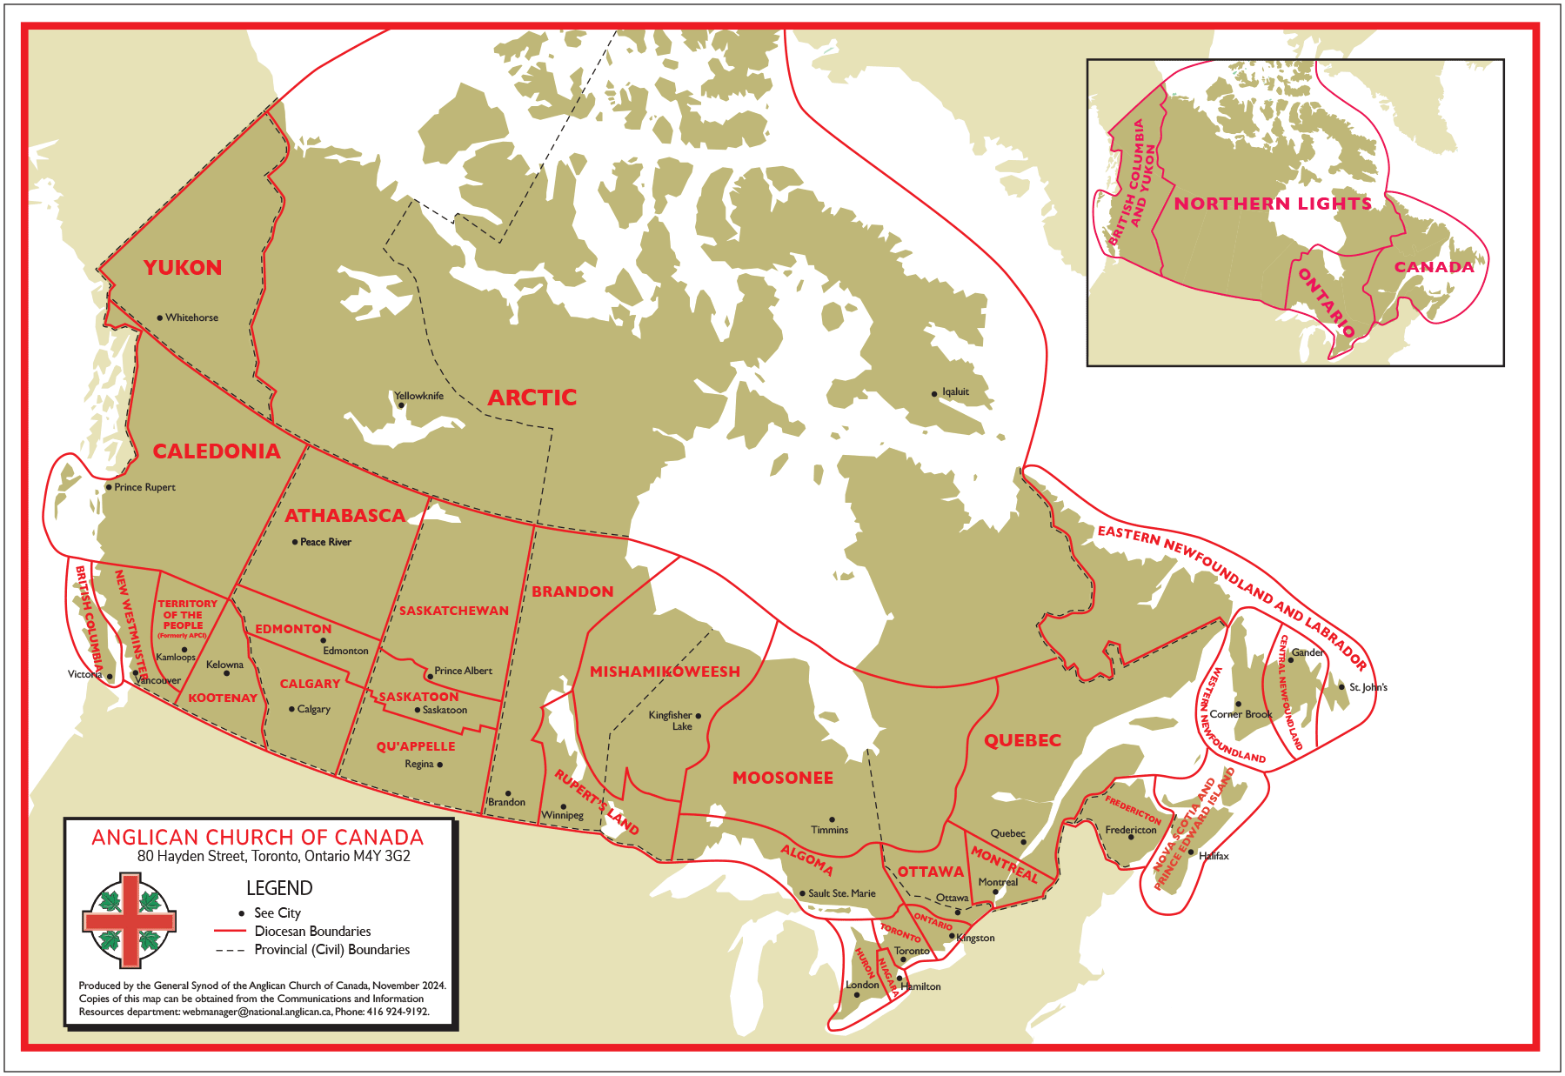
Notes:
Establishing Provinces and General Synod
Province of Canada 1861
Province of Ontario 1862
Province of Rupert’s Land 1875
General Synod 1893
Province of British Columbia and Yukon 1914
The Church of England in Canada renamed as the Anglican Church of Canada 1955

Slide 27
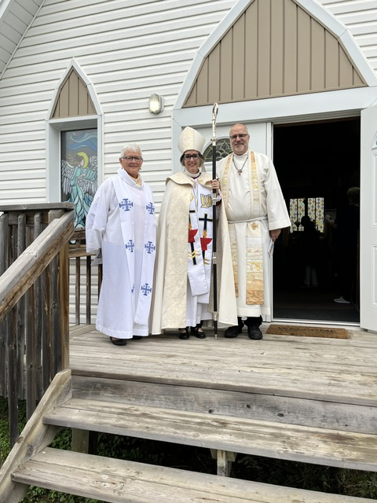
What are the Roles of the Bishop?
How People Experience
the Bishop?
Notes:
Ask, what does the Bishop do?

Slide 28
How People Experience the Bishop?
when the Bishop visits their parish, about every
2 years
when they are confirmed
when they attend an ordination
when they attend the funeral of a priest or deacon that the Bishop conducts

Slide 29
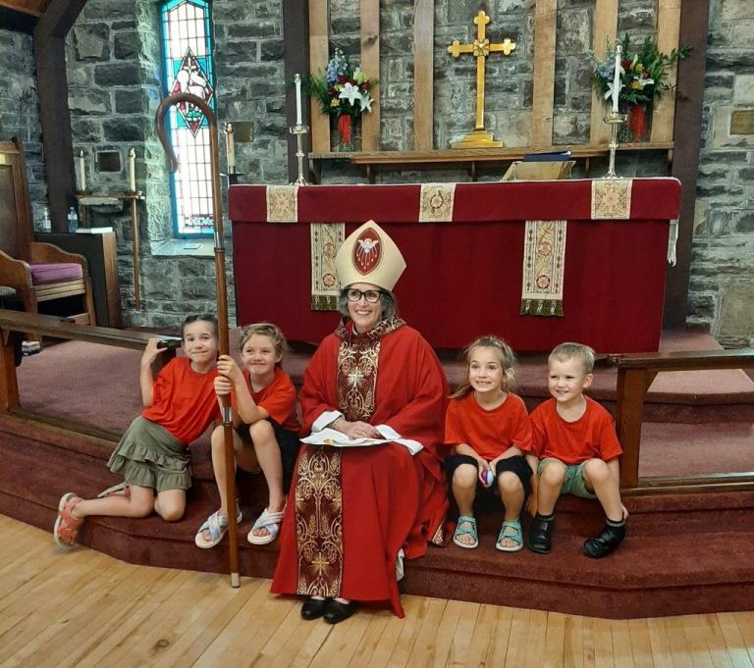

Slide 30
How People Experience the Bishop?
when they participate in a Deanery teaching day
in which the Bishop gives a talk
through the written word communicated in:
  Diocese of Algoma – Latest News sent by email and
  posted on www.dioceseofalgoma.com
  posts on Facebook,
  pastoral letters to the diocese, and
  Ad Clerum to clergy

Slide 31
How People Experience the Bishop?
as a member of Diocesan Synod
as a member of Diocesan Executive Committee
when they attend a Diocesan clergy retreat
when they attend a Diocesan Lay Reader conference

Slide 32
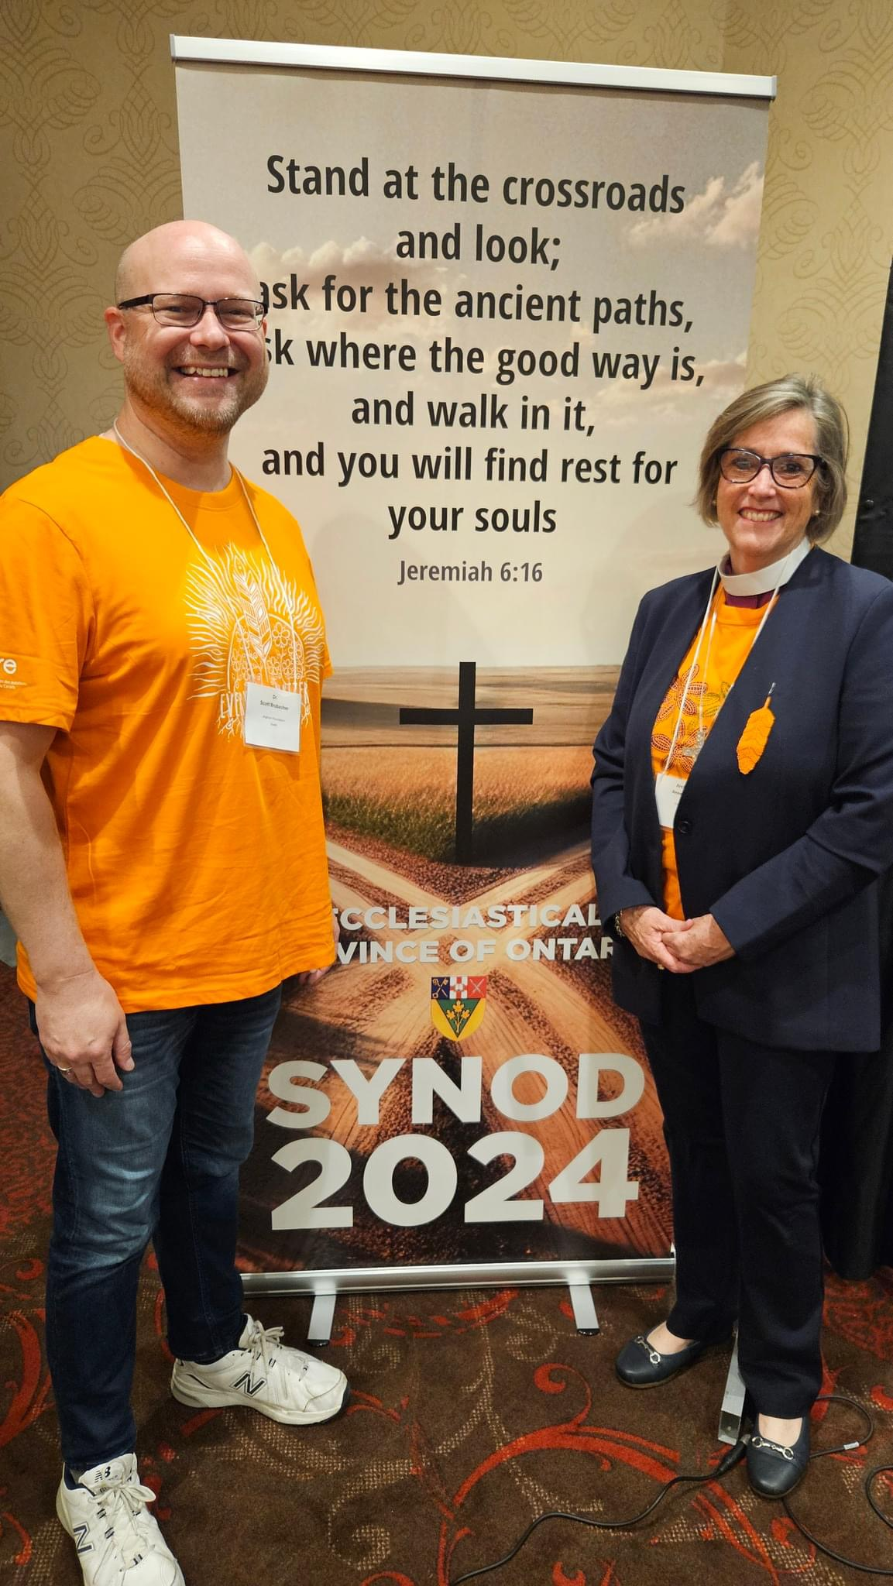

Slide 33
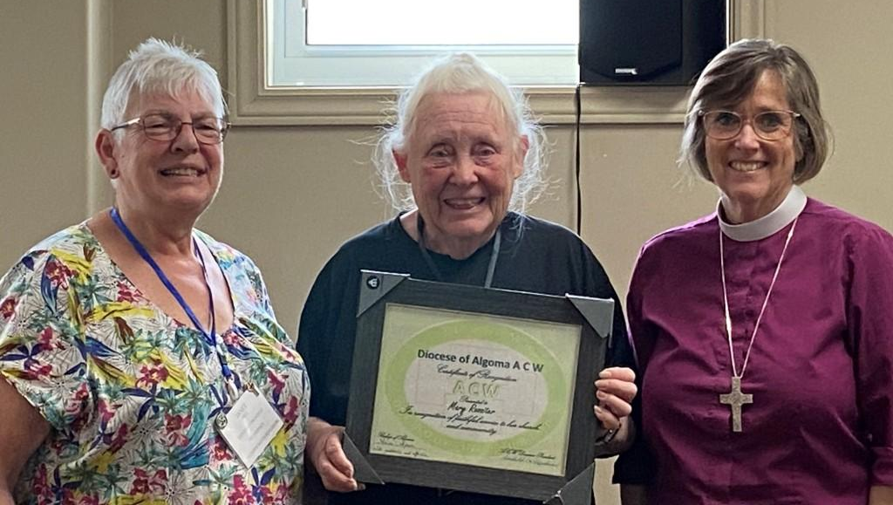
How People Experience the Bishop?
through ecumenical events that the Bishop participates in, such as the Week of Prayer for Christian Unity and the World Day of Prayer
whey they attend a
Diocesan ACW Annual
meeting

Slide 34
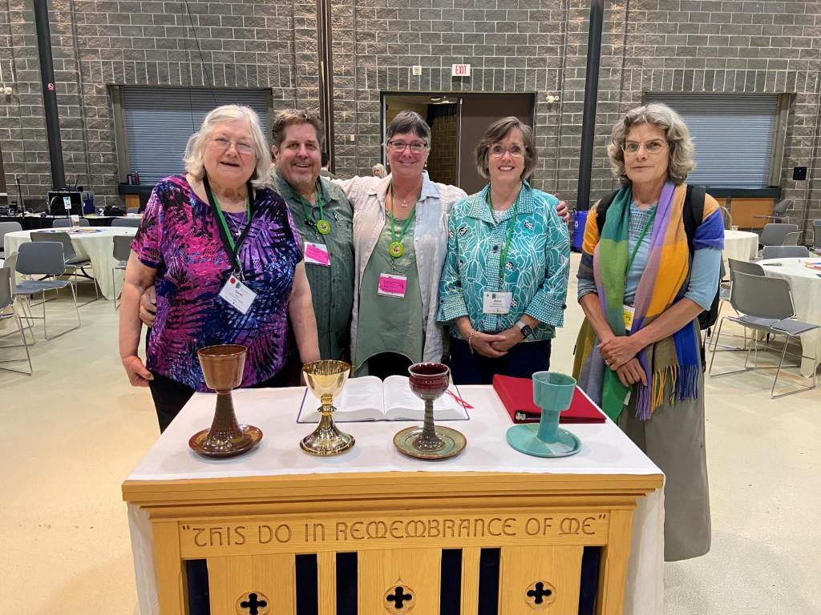

Slide 35
How People Experience the Bishop?
when their parish is filling the vacancy of the Incumbent
through ministry reviews with church wardens and the incumbent
when their parish has a conflict with the Synod Office, or when their parish has an internal conflict, and the Bishop intervenes
Notes:
Archdeacon and Deanery Officials initial recourse for a conflict, then the Bishop

Slide 36
Roles understood from People’s Experience
leadership and management of the Diocese – oversight - care for parishes
teaching - missional leadership
raising up vocations to the diaconate and priesthood (ordination)
provision of sacraments: confirmation

Slide 37
Prayer and Study
A bishop maintains a practise of prayer and study
If a bishop is to be a good teacher/preacher, time for lifelong learning and retreat is essential to every bishop’s life and ministry

Slide 38
Work in the Province
attends Provincial House of Bishops
attends Provincial Synod, held once every 3 years
attends Provincial Council, meets in the spring and in the fall
may serve on a Provincial committee(s)
participates in consecrations of bishops within the Province

Slide 39
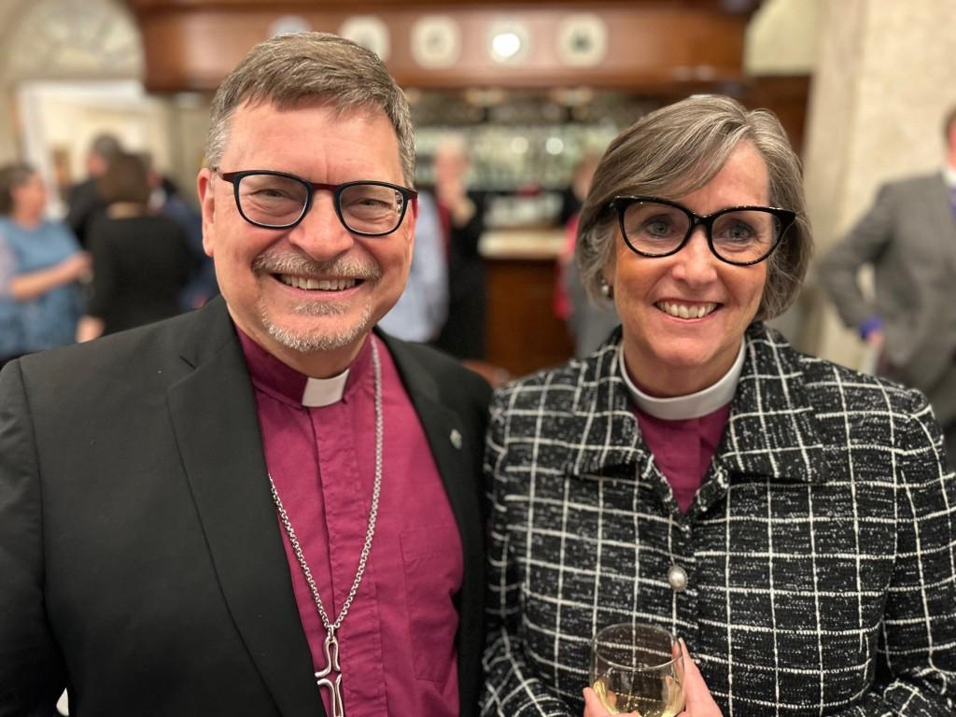

Slide 40
Work in the National Church and Anglican Communion
attends National House of Bishops,
meets in the spring and fall - one week each
attends General Synod, held once every 3 years
may serve on General Synod Council or committee(s)

Slide 41
Work in the National Church and Anglican Communion
Every bishop is asked to participate in a ministry of the Anglican Church of Canada or the Communion.
Attends the Bishops of the Communion Conference (Lambeth Conference), held once every 10 years at Lambeth Palace.
Notes:
+Linda was a member of ARCIC; +Andrew is in England attending Compass Rose. For six years +Anne was on the board of the Anglican Foundation of Canada. All these ministries provide a vital link between the bishop and other organizations as the bishop offers their gifts of ministry.
The Archbishop of Canterbury first convened the Lambeth Conference in 1865 at the request of the Canadian House of Bishops. Bishop Strachan conceived of the idea.
Connects our Diocese with the wider church and the wider church with our Diocese. In doing so, the Bishop is an instrument of unity.

Slide 42
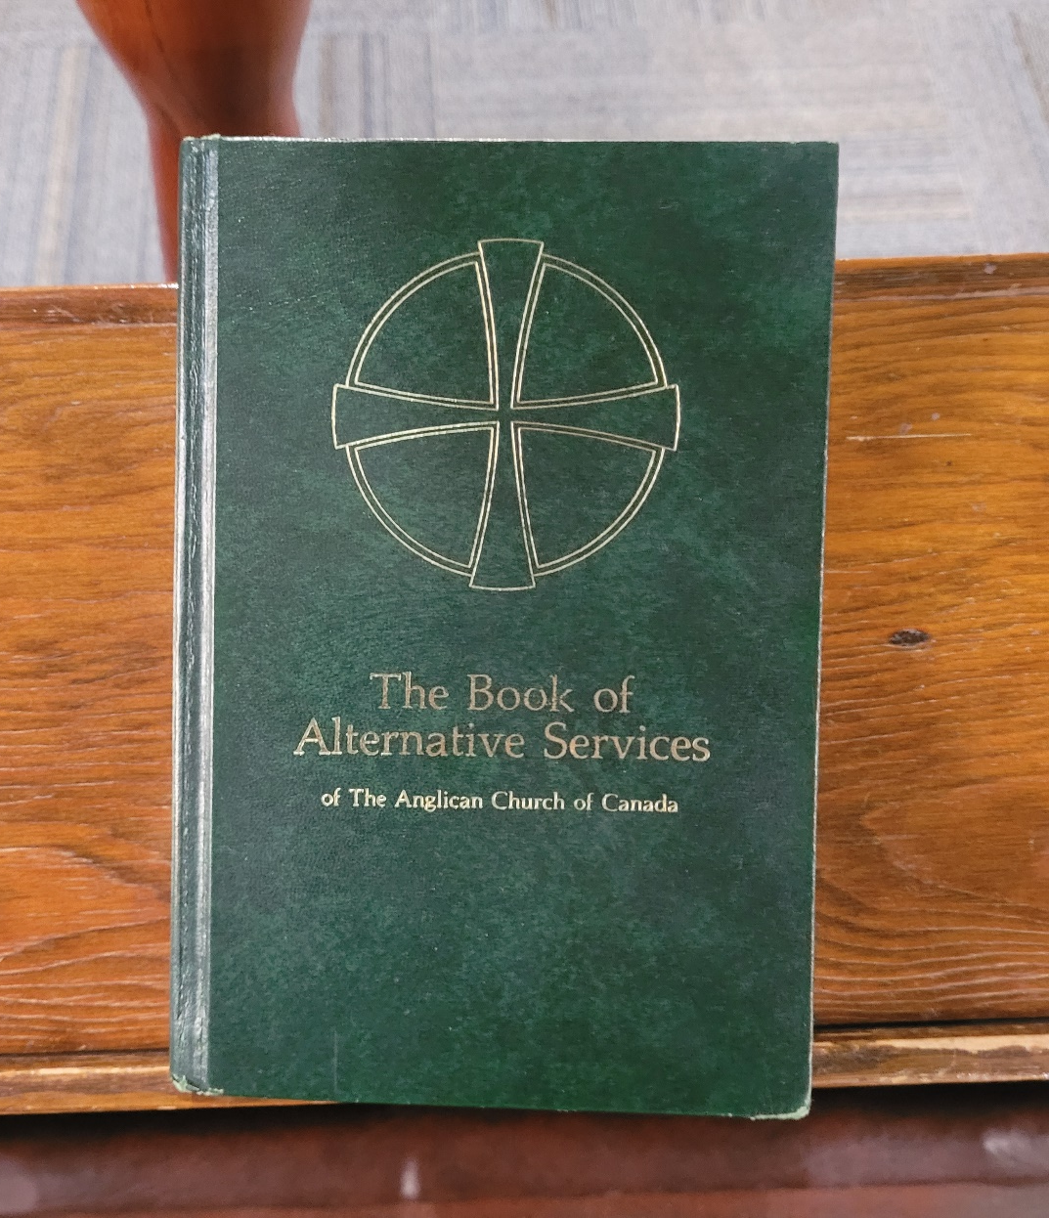
What are the Roles of the Bishop?
From the Ordinal

Slide 43
The Ordination of a Bishop, the Examination
Anne, the people have chosen you and have affirmed their trust in you by acclaiming your election.
A bishop in God’s holy Church is called to be one with the apostles in proclaiming Christ’s resurrection and interpreting the Gospel, and to testify to Christ’s sovereignty as Lord of lords and King of kings.

Slide 44
The Ordination of a Bishop, the Examination
You are called to guard the faith, unity, and discipline of the Church; to celebrate and to provide for the administration of the sacraments of the new covenant; to ordain priests and deacons, and to join in ordaining bishops; and to be in all things a faithful pastor and wholesome example for the entire flock of Christ.

Slide 45
The Ordination of a Bishop, the Examination
With your fellow bishops you will share in the leadership of the Church throughout the world. Your heritage is the faith of patriarchs, prophets, apostles, and martyrs, and those of every generation who have looked to God in hope. Your joy will be to follow him who came not to be served but to serve, and to give his life a ransom for many.
BAS p. 636

Slide 46
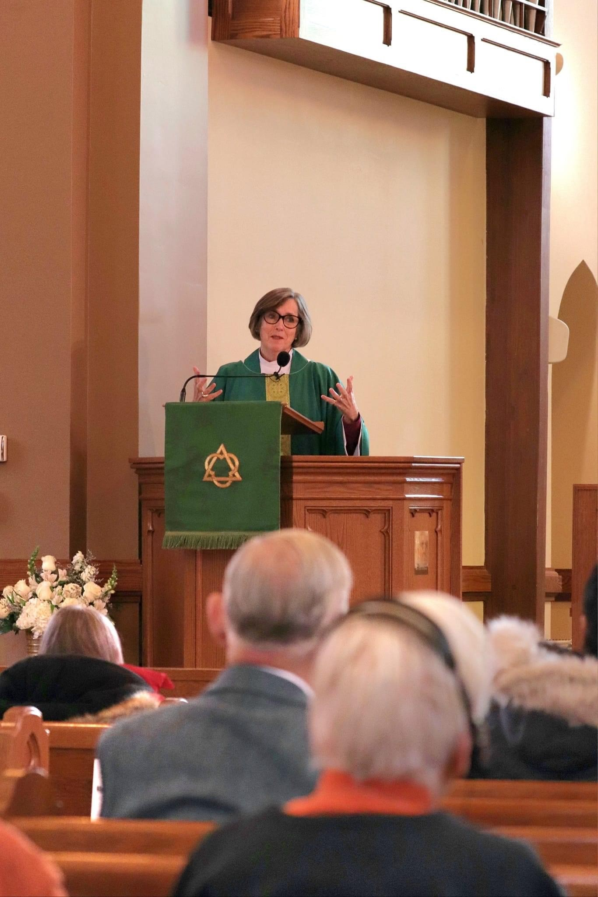
Guard the faith, unity, and discipline of the Church

Slide 47
Continuity - Successor of the Apostles
Bishops continue the work of the apostles in three ways:
  upholding, expounding and promoting the apostolic faith;
  leading the faithful in the apostolic mission of the gospel in the midst of the world; and
  being a visible link through history, by continuous succession, with the Church of the apostles.
Becoming a Bishop p. 24

Slide 48
Teacher and Defender of the Faith
through their own teaching/preaching
raise up others to teach
ensure opportunities for teaching to occur, such as Diocesan Clergy Retreat and Diocesan Synod
missional aspect is when teaching becomes apologetic, i.e. explain Christianity to the wider society

Slide 49
Teacher and Defender of the Faith
Monitor situation in the church and respond appropriately.
Correct inappropriate teaching, exercise discipline with clergy and lay people appointed to positions in the Diocese.
Notes:
The General Synod Canon on Discipline lists heresy as an offense.
Echo of St. Ignatius.

Slide 50
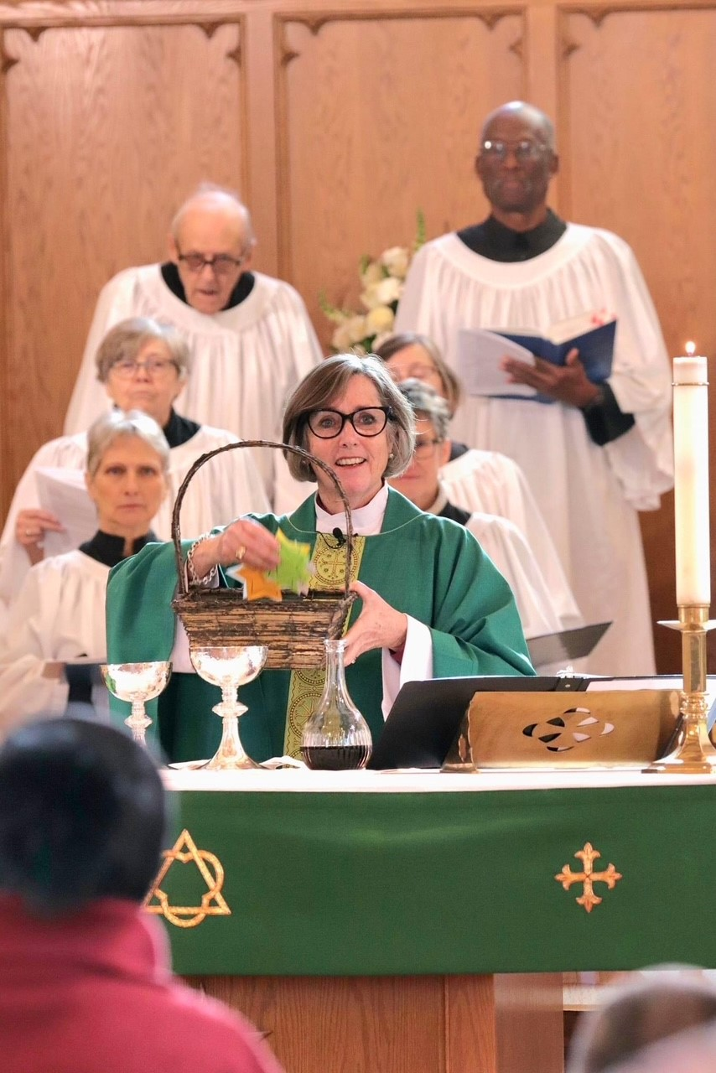
Provide for the
Administration of the
Sacraments of the New Covenant

Slide 51
Provide for the Administration of the Sacraments of the New Covenant
Incumbents, normally priests (presbyters), are licenced to spiritual and pastoral care for a parish.
When there is no Incumbent, the Bishop ensures that clergy or Diocesan Lay Readers provide spiritual and pastoral care and administer the sacraments.
The Bishop continues as a priest and may provide spiritual and pastoral care for a parish.

Slide 52
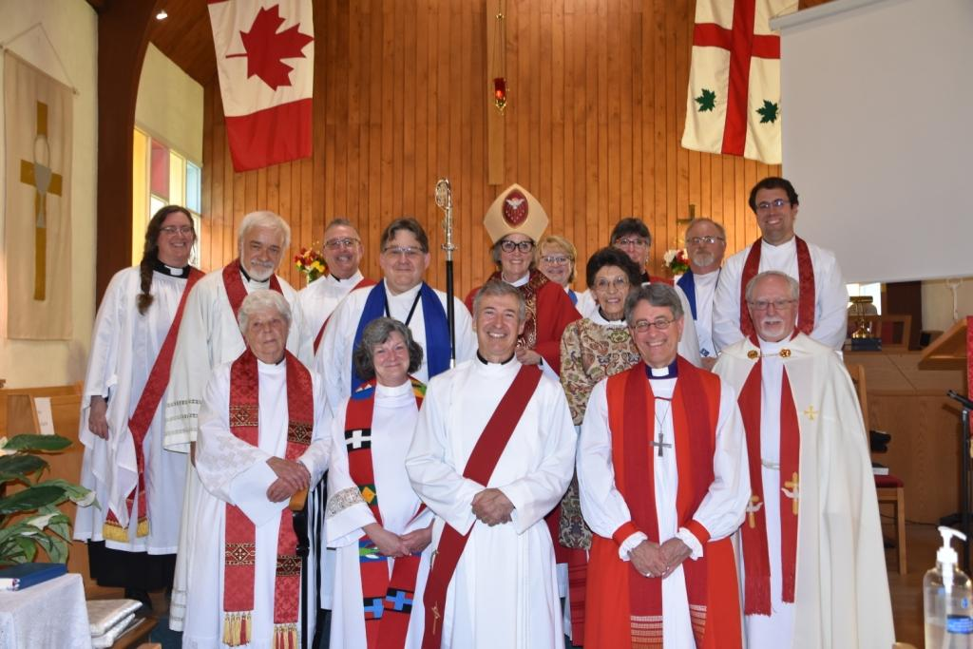
Ordain Priests and Deacons, and to Join in Ordaining Bishops

Slide 53
Raising Up Vocations
The Bishop will work with incumbents, archdeacons, pastoral chaplains, and theological colleges to mentor and select candidates for ordination (postulants).
A pastoral chaplain is a priest or bishop that the Bishop appoints for each deanery to assist in talking with those discerning a call to ministry.

Slide 54
Raising Up Vocations
The Bishop meets with the Diocesan Postulancy Commission to decide whether to ordain people.

Slide 55
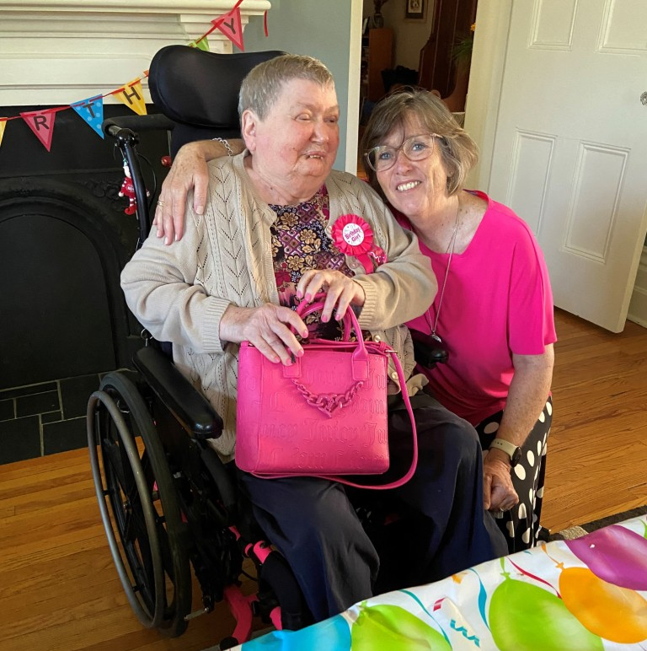
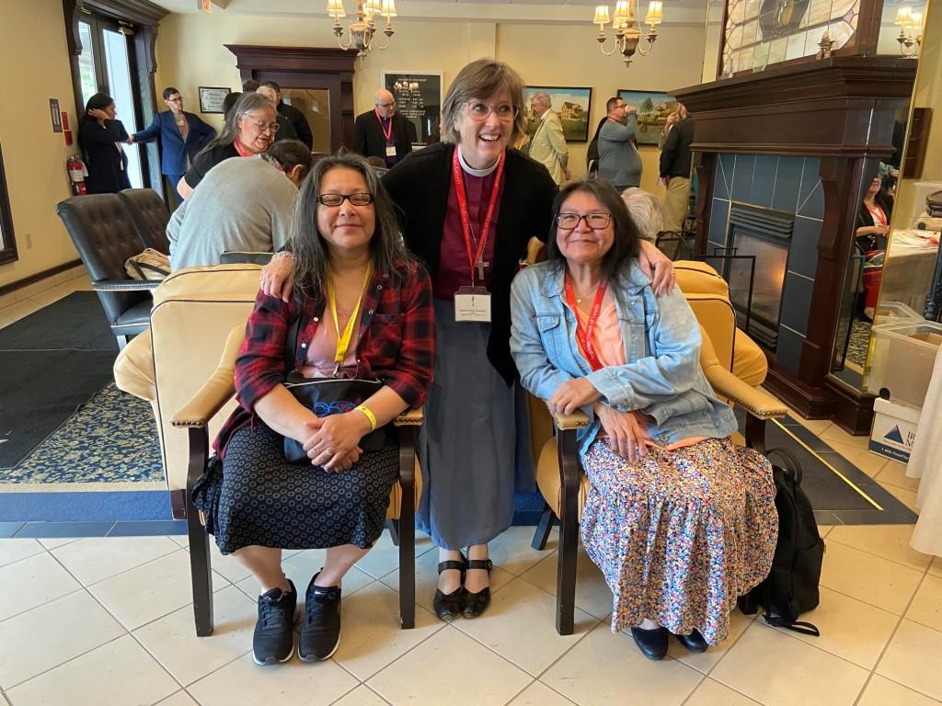
Be in all things a faithful pastor and wholesome example for the entire flock of Christ

Slide 56
Care for Congregations
The Bishop licences Incumbents, normally priests (presbyters), to provide spiritual and pastoral care for a parish.
Archdeacons are appointed to assist the Bishop in the oversight of parishes, and Territorial Archdeacons represent the Bishop in their deanery.

Slide 57
Care for Congregations
The Bishop is responsible for ensuring internal conflicts and issues between the Incumbent and parish are resolved, if they are not able to resolve it themselves.
The Bishop may exercise a discipline function with clergy and lay people appointed to positions in the Diocese.

Slide 58
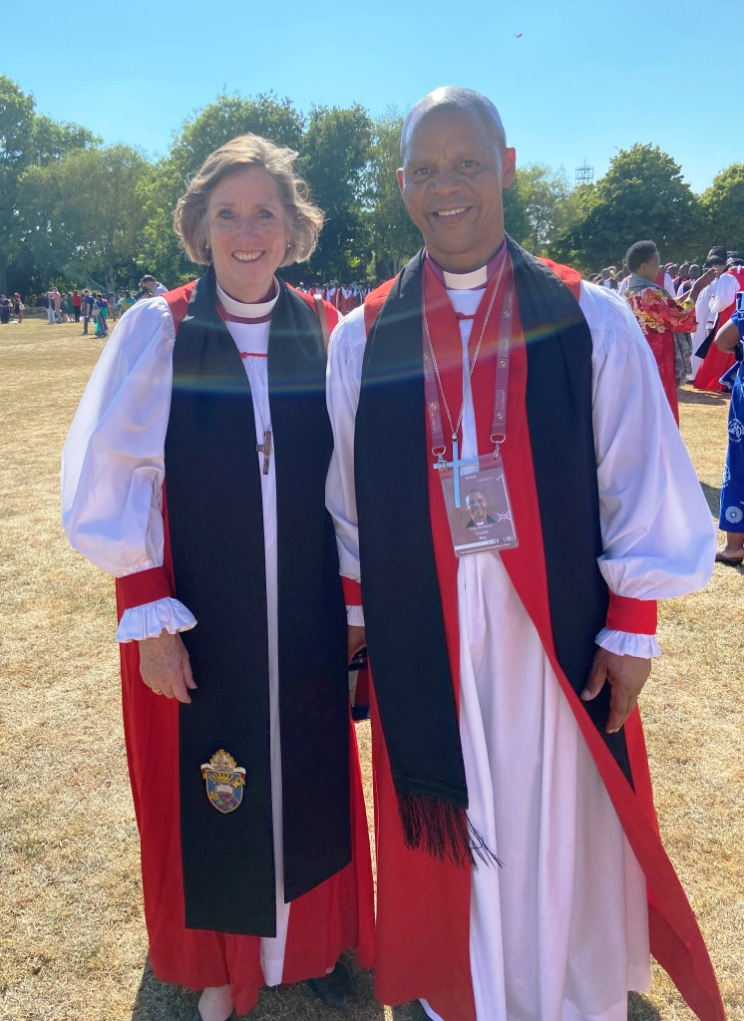
With your fellow bishops you will share in the leadership of the Church throughout the world

Slide 59
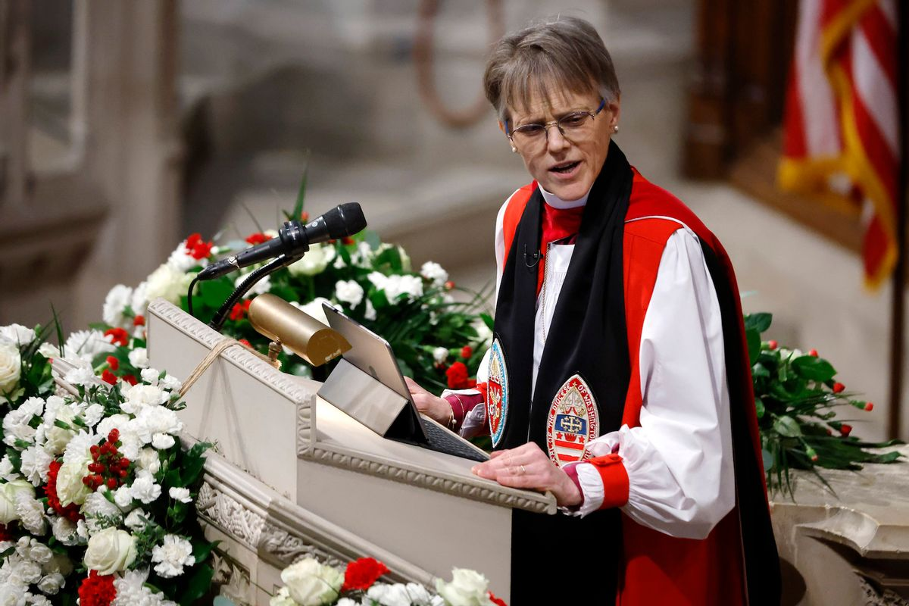
Continuity - Instrument of Unity
As chief pastor, the Bishop links one parish to another, representing the diocese to the wider church and the wider church to the diocese.
Bishops often are on the
forefront of local, national,
and global issues, speaking
the word of faith to the needs
of the world.
Notes:
Expand being an instrument of unity
Bishop Mariann Budde of the Diocese of Washington

Slide 60
Continuity - Instrument of Unity
Bishops are one vital and visible way of showing that the Anglican Church is a continuation of the original Apostolic church.
Bishops provide leadership for ecumenical dialogues.

Slide 61
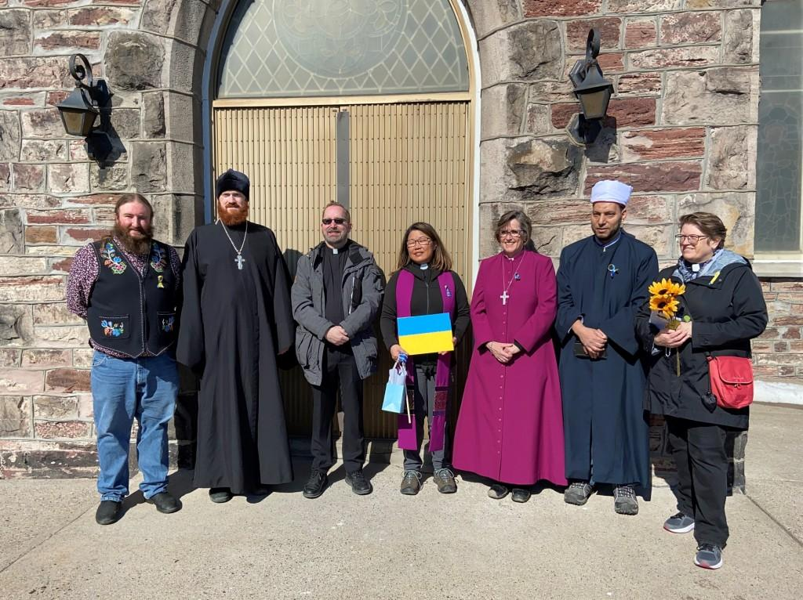

Slide 62
Episcopally-led
To oversee the Diocese, the Bishop listens to the clergy and people, develops courses of action with them, and with them, discerns Jesus’ and the Holy Spirit’s leading.
In the oversight of the Diocese,
the Bishop is guided by scripture, the tradition of the church, and reason.
Notes:
Persuade a group of people to accomplish something

Slide 63
Synodically-governed
Synod is comprised of 3 houses, Bishop, clergy and people, and for decisions to pass each house must agree.
Synod is a legislature.
In Algoma, Diocesan Synod meets every 2 years.
In the clergy and people, there are tremendous gifts and resources, including financial resources.
Notes:
Discuss the 3 houses of Synod in Diocesan Synod. The House of Bishop has one member, and it operates when concurrence is given or withheld at the closing of Synod.
As a legislature, Synod passes canons (laws) and motions that become policy or direction for the Executive Committee, deaneries and parishes.

Slide 64
Why does Algoma need to be led by a local Bishop?

Slide 65
What are the Alternatives?
The people of Algoma will always have a bishop.
If Algoma cannot fund a bishop, other arrangements will be made, but the Bishop will not reside in Algoma:
  as in the case of Moosonee, the Metropolitan may provide oversight temporarily; or
  a permanent solution would be the realignment of the Diocese with other dioceses.

Slide 66
Benefits of a Local Bishop
One with the time and resources to walk alongside congregations, visit deaneries, and strengthen the ties that bind our faith community.
Understands better the particular context of northern Ontario and more able to speak for the people of this region.

Slide 67
Benefits of a Local Bishop
More able to raise up vocations.
Better placed to guide parishes through change, foster innovation, and create new opportunities for collaboration.

Slide 68
Conclusion
The success of this campaign will ensure that:
  the office of the Bishop is funded
  our diocese will be led by a local Bishop
  the Bishop offers episcopal ministry, and
  Anglican ministry is supported in our communities by a Bishop who understands the life of northern Ontario.

Slide 69
Discussion
What did you learn about the Bishop?
Is it important to retain a local Bishop? If so, why?
Have you experienced the ministry of the Bishop?

Slide 70
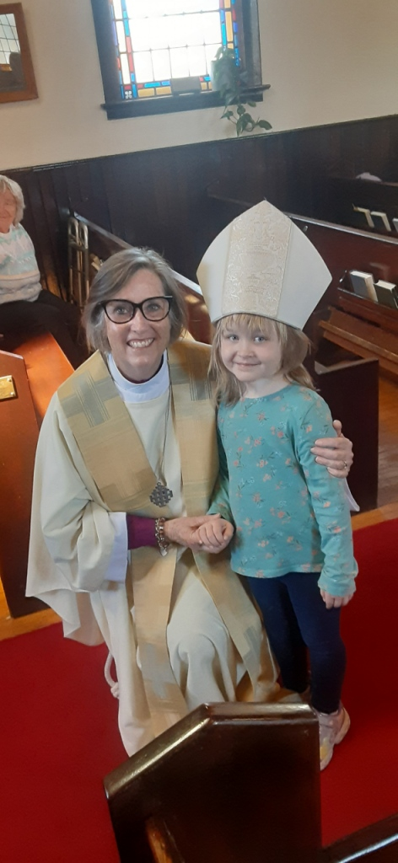
For More Information
www.anneslegacyfund.ca
  donation page
  information
  downloadable resources
anneslegacyfund@dioceseofalgoma.com

